Slide 1
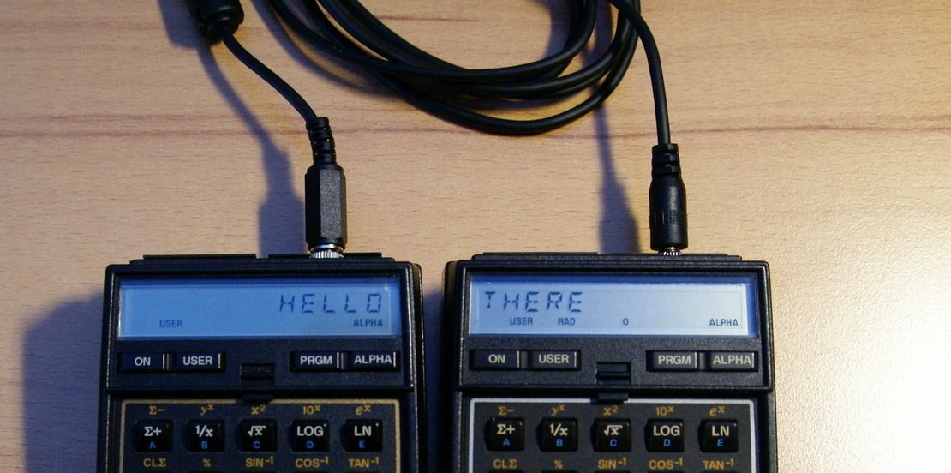
The HP-41 EEE^{(*)} Experience
Teaching New Tricks to an Ol’Dog
Ángel M. Martin – November 2018
Multi-Threaded Coconuts, anybody?
(*) Extended, Expanded, Enhanced… premium unleaded

Slide 2
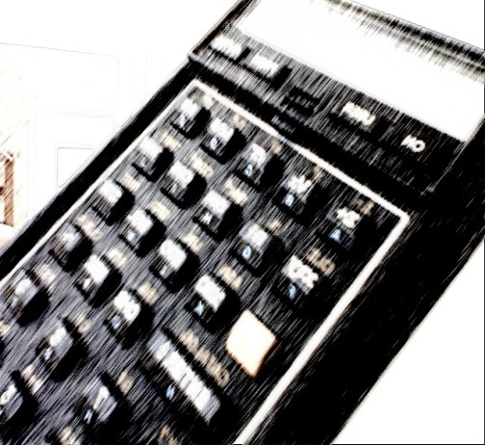
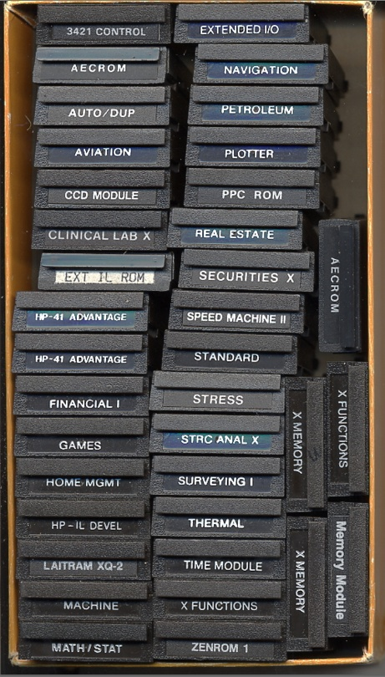
Presentation Agenda:
Library#4 Concept and Reach
Auxiliary FATs and Banked FATs
Sub-functions, Launchers and Last-Function
Auto-Complete XEQ+, Universal Execute XEQ$
Loading and Interrogating the I/O Bus
Advanced Modules Summary
OS/X and Utilities ROMS
System Extension Modules
Emulators and Informatics ROMS
Math Extension Modules
Science & Engineering ROMS
From Solve to Solver: Equation Libraries
Rest & Relaxation
Adapted Books and Literature
Acknowledgments
Appendix: System Memory and MLDL Modules

Slide 3
[4LIB] Library#4: A sorta MindMap
Power_CL Extreme
Y-REGS
YREGS Apps.
CL XP-MEM
HEPAX_4H
41Z Deluxe
41Z Diagnostics
Advtg. Math
SandMatrix
Page Fns.
XP-MEM
HP’s UMS+
ALPHA_4
RAMPage
ToolBox
Library #4
CLCAT
UMS
Advtg. Matrix
Vector Calc.
AUX FATs & CAT+
LASTF, Buffer Admin
SandMath
Elliptics ROM
Areas & Σums
ierf ROM
Solve & Integ
XM Stats
Curve Fitting
TVM$
Special Funs.
Recursion & MA
Vector Calc.
AMC_OS/X
WARP_Core
RCL Math
AEC Fitter
AEC Solvers
RAM Editor
Auto-Complete
TOTAL REKALL
16C Emulator
Formula Eval
CCD OS/X
Hepax DISASM
TVM$
S&I
Universal Execute
AEC PROG
Hepax HEXED
Enhanced CX’s ED
Eval$ Apps; Equation Lib$

Slide 4








Auxiliary & Banked FAT Concept
0xp000
0xp000
Main FAT
64 Fns max
Banked FAT #1
Unlimited Size
Banked FAT #2
Unlimited Size
Banked FAT #3
Unlimited Size
XF#
XF$
0xp083
0xp800
0xp800
Aux FAT
Unlimited Size
Aux-Banked FAT #1
Unlimited Size
Aux-Banked FAT #2
Unlimited Size
Aux-Banked FAT #3
Unlimited Size
0xp8xx
0xpFF4
SSEP / ROMID
0xpFFF
bank #0
bank #1
bank #2
bank #3

Slide 5
Advanced Modules Vital Signs
 | Original Advanced Modules Architectural Details
IMDB / Module Name |  | XROM# | Lib#4 | Sub-Fncs | Banked | SVC_IO | Buffers
 |  | Next-Gen Advanced Modules Architectural Details
IMDB | Module Name |  | XROM# | Lib#4 | Sub-Fncs | Banked | SVC_IO | Buffers
16CS | 16C Emulator |  | 16 | √ | √ | √ | - | #9; #11
Z4DL | 41Z Deluxe |  | 01, 04 | √ | √ | √ | - | #8; #9
441Z | 41Z Standard |  | 01,04 | √ | - | - | - | #8; #9
4ALP | ALPHA_44 |  | 06 | √ | - | - | - | -
OSXB3 | AMC_OS/X_XL |  | 05 | √ | √ | √ | √ | #5, #9
AOSX | AMC_OS/X |  | 05 | √ | - | √ | √ | #5
XPMM | CL_XMEM (Y-Regs) |  | 20 | √ | √ | - | - | #9
CRTO | Cryptography |  | 10 | √ | - | - | - | #9
EPTC | Elliptics ROM |  | 17 | √ | - | - | - | -
FRML | Formula Eval |  | 31 | √ | √ | √ | - | #6,#7, #9
HPX2 | HEPAX 4H |  | 06 | √ | √ | √ | - | #9
METX | Metro Paths |  | 30 | √ | - | - | - | -
PWCL | PowerCL |  | 12 | √ | √ | √ | - | #9
PWRX | PowerCL_Extreme |  | 12 | √ | √ | √ | - | #9
4RAM | RAMPage |  | 17 | √ | - |  | - | -
SM44 | SandMath |  | 02, 03 | √ | √ | √ | √ | #5; #9; #14
4MTI | SandMatrix & Vector Calc |  | 22, 24 | √ | √ | √ | - | #5; #9
SERI | Series & Sums |  | 18 | √ | - | - | - | -
4TBX | ToolBox |  | 13 | √ | - | - | - | -
TRKL | TotalRekall / DTC |  | 21 | √ | √ | - | √ | #7; #9
TRKL | TotalRekall / UMS |  | 21 | √ | - | - | √ | -
UNIT | Unit Conversion ROM |  | 10 | √ | - | - | - | -
WARP | WARP_Core |  | 30 | √ | √ | √ | √ | #7, #9
ROMX | XROM ROM |  | 31 | √ | - | - | - | -
AEC3 | AECROM | 18 | - | - | - | √ | -
ZENR | ZENROM | 05 | - | - | - | √ | -
ZEPM | ZEPROM | <nn> | - | - | √√√ | ? | ?
HEPX | HEPAX 1D | 06 | - | √ | √ | - | -
CCDR | CCD Module | 09, 11 | - | - | - | √ | #5
41AD | 41 Advantage | 22, 24 | - | - | √ | √ | #5, #14
Buffer id# | Size | Type | Purpose
05 | <= 3 | Auto | Word Size – Matrix Name – Seed/RNG
06 | 16 | Auto | Formula Evaluation (Operators & Factors)
07 | 6 | Man | Shadow Stack Emergency Storage; RTN Stack backup
08 | 12 | Auto | Complex Stack
09 | 6 | Auto | LAST Function (5x Single entries) LAST 5-Functions (1x 5 entries)
11 | 24 | Auto | 16C Stack (64-bit Words)
14 | 14/32 | Auto | Data for FROOT – FINTG

Slide 6
The Last (Sub)Function Storage
Beware of double-duty buffers !
LASTF from individual Launchers (*)
Shadow Stack / Evaluation Vars
Buffer id# | Buffer Reg | Type | Used by:
09 | b5 | ID# or Name$ | CL-Xmem / WarpCore / GJM ROM
 | b4 | ID# or Name$ | SandMatrix
 | b3 | ID# or Name$ | SandMath
 | b2 | ID# or Name$ | PowerCL / AMC_OS/X
 | b1 | ID# or Name$ | 41Z Deluxe / 16C Emulator
 | b0 | ID# | Header – Standard 41Z Module
Buffer id# | Buffer Reg | Type | Used for:
07 | b5 | BCD value | L-Reg / “e”
 | b4 | BCD value | T-Reg / “d”
 | b3 | BCD value | Z-Reg / “c”
 | b2 | BCD value | Y-Reg / “b”
 | b1 | BCD value | X-Reg / “a”
 | b0 | admin | Header
(*) See tables in next slides
LAST5 from XEQ+ / XEQ$ -- “LIFO”
Emergency Storage – RTN Stack
Buffer id# | Buffer Reg | Type | Used for:
09 | b5 | ID# or Name$ | Fifth function
 | b4 | ID# or Name$ | Fourth function
 | b3 | ID# or Name$ | Third function
 | b2 | ID# or Name$ | Second function
 | b1 | ID# or Name$ | First function
 | b0 | admin | Header
Buffer id# | Buffer Reg | Type | Used for:
07 | b5 | bR5 value | -
 | b4 | bR4 value | -
 | b3 | bR3 value | -
 | b2 | bR2 value | reg 10(a)
 | b1 | bR1 value | reg 11(b)
 | b0 | SEL# pointer | -

Slide 7












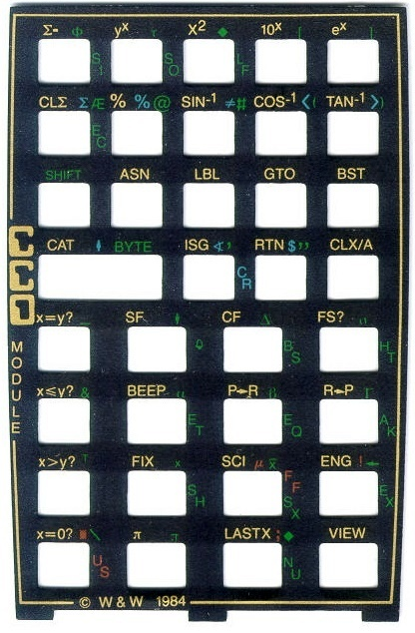







AMC_OS/X Highlights
[OSX3]
RAM Program Compile & Page Utils
File type | CAT’4 Mnemonic | File Type Id#
Program | “P” | 01
Data | “D” | 02
ASCII | “A” | 03
Matrix | “M” | 04
Buffers | “B” | 05
Key Assignments | “K” | 06
Status Registers | “T” | 07
Complex Stack | “Z” | 08
Polynomial | “L” | 09
FORTH code | “F” | 10
HEPAX Data | “H” | 11
,
“ON-key” Prompt Lengthener (also for STO/RCL)
Page/ROM Checksums
Special Char$ Keyboard

Slide 8



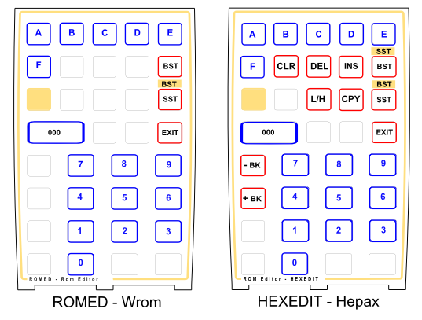

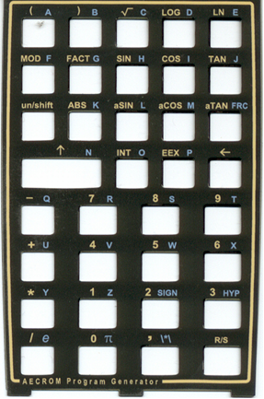

AMC_OS/X Highlights (Con’t)
AECROM’s Program Generator
HEPAX’ Disassembler & HEXEDIT
Håkan’s RAM Editor
Read/Write XMem to IL-Drive
Buffer Catalog (w/ View & Deletion)
22 Sub-functions & LastF support

Slide 9
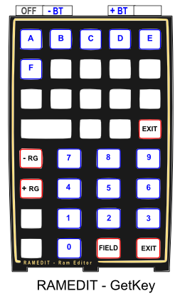






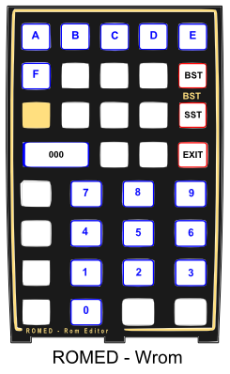


Other Utility Modules
Buffer Management Fns.
X-Mem Management Fns.
Hacker’s Lab
Jump’s Calculator
GOSUB/GOTO Decoder
BCDBIN, BINBCD
Håkan’s RAMEDIT
ZENROM’s RAMED
BLDROM’s ROMED
VASM <> HEX Decoder
ALPHA_4
RAMPage
ToolBox
ALPHA Utilities Galore
“Dr. Jekyll's & Mr. Hyde” FAT
ALPHA Fns.
LCD Fns.
XROM ROM
Byte Jumpers
Direct Byte Loading
Multi-Digit Prompts
HEX <> XROM
Other (Weird & Obscure)

Slide 10
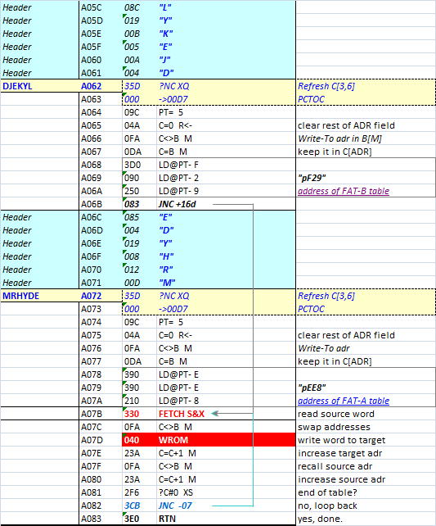

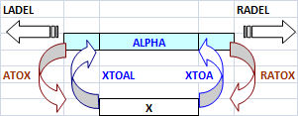
Dr. Jekyll & Mr. Hyde

Slide 11





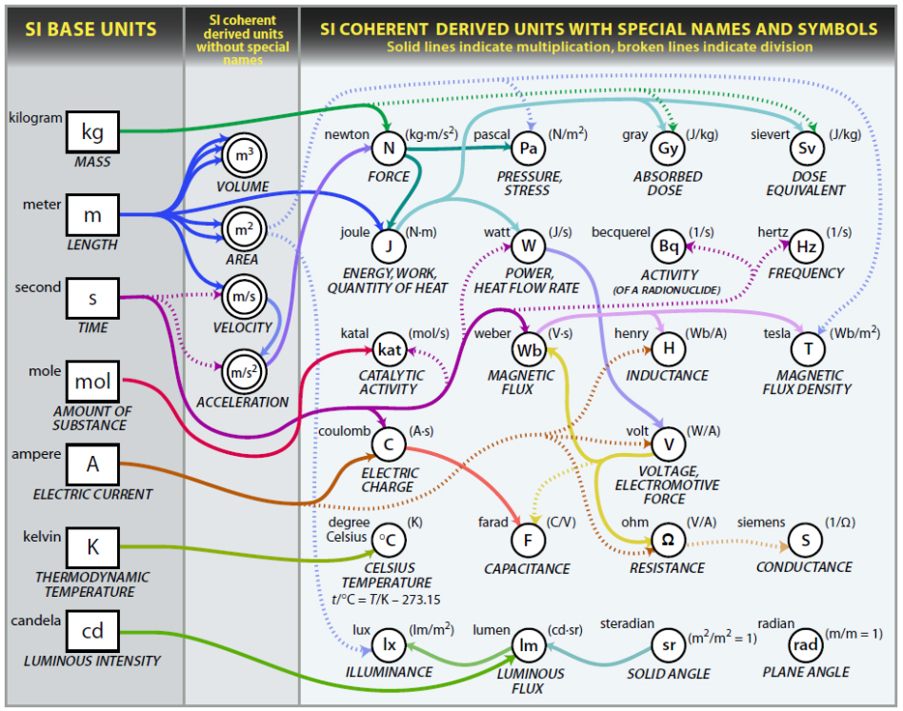




Enhanced Unit Management System (UMS+)
Adds two more Dimensions (primes!)
Adds 12 Electricity & Light Magnitudes
Adds 29 new units to the Tables
Features Unit Catalog(s) (by groups)
New 20-Constant Library (values & units!)
INPUT/OPUTPUT Routines
HP’s UMS+
w/ KLIB, UCAT

Slide 12



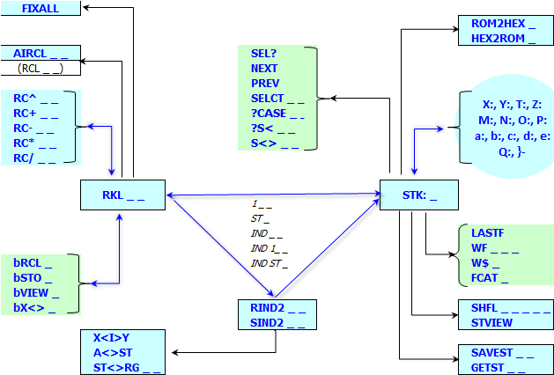
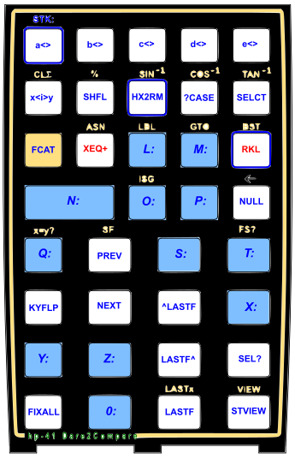
The “Total Rekall” Schema
https://www.imdb.com/title/tt0159920/
Round about and back throughout…
RCL Math (not using IO_SVC polling point)
92 Sub-functions & LastF support
-STK_Tests Launcher
Rekall Math
AutoComplete
Select/Case

Slide 13








Two Decoder Ring(s)
Register | Exchange | Tests |  | Register | Exchange | Tests
X | Main | Main |  | Q | Main | Sub-fcn
Y | Main | Main |  | |- | Sub-fcn | Indirect
Z | Main | Main |  | a | Sub-fcn | Indirect
T | Main | Main |  | b | Sub-fcn | Indirect
L | Main | Main |  | c | Sub-fcn | Indirect
M | Main | Sub-fcn |  | d | Sub-fcn | Indirect
N | Main | Sub-fcn |  | e | Sub-fcn | Indirect
O | Main | Sub-fcn |  | “0” | n/a | Main
P | Main | Sub-fcn |  | Rnn | Main | Indirect
TRK / DTC functionality
RCL Math (includes RC^)
SLCT Variable for integer CASE?
Square² IND (X<I>Y, ?S# IND _ _)
Multiple IND (RIND/SIND) – up to 10 levels
. . . .
Register Index Mapping
Arguments above “99”
Partially occupied by STK regs
Falls into IND scheme over “127”
Warps around over “199” (IND 71)
Argument | Shown as: |  | Argument | Shown as: |  | Argument | Shown as:
100 | 00 |  | 112 | T |  | 124 | b
101 | 01 |  | 113 | Z |  | 125 | c
102 | A |  | 114 | Y |  | 126 | d
103 | B |  | 115 | X |  | 127 | e
104 | C |  | 116 | L |  | 128 | IND 00
105 | D |  | 117 | M |  | 129 | IND 01
106 | E |  | 118 | N |  | 130 | IND 02
107 | F |  | 119 | O |  | 131 | IND 03
108 | G |  | 120 | P |  | 132 | IND 04
109 | H |  | 121 | Q |  | 133 | IND 05
110 | I |  | 122 | |- |  | 134 | IND 06
111 | J |  | 123 | a |  | 135 | IND 07

Slide 14
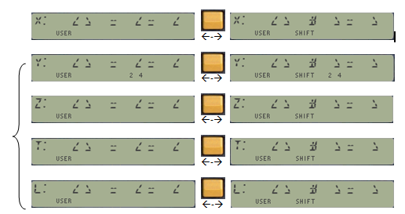
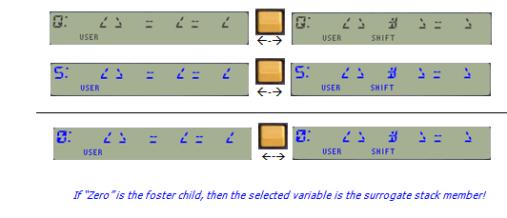
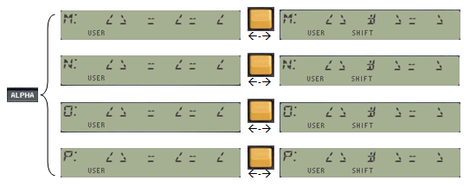


Dare to Compare Interconnectivity
Smooth & Flexible U/I
Sweeps the practical Stack range
84 function-launcher overview
Direct zero-comparison for registers
Supports Indirect-Indirect tests

Slide 15










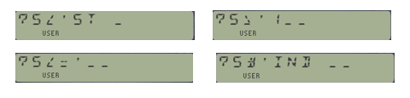

SELECT your Weapon !
1. ready (Define)…
2. aim (Store, Recall, Swap)…
3. fire (Compare)!
WARP_Core
The Many ways to skin this cat
Auto-Complete
TOTAL REKALL
Universal Execute
Enhanced CX’s ED
Wildcard variable selection & management
=
=
Interwoven functional areas
Proxy for surrogate Register Use

Slide 16






Auto-Complete XEQ+ (a.k.a Bus Navigator)
Auto-Complete
Native’s XEQ
Universal Execute
WARP_Core Launchers & LastF
Assign Main Fnc
Next / Previous Func.
Module | Aux/Banked FAT Location | Launchers | # Sub-Fncts
41Z Deluxe | Middle of Lower page | ZF$, ZF# | 62
AMC_OS/X | Middle of page | XF$, XF# | 22
CL X-Mem Manager | Middle of page | YF$, YF# | 22
Formula Evaluation | Middle of page | SF$, SF# | 24
GJM ROM | Middle of page | GJM$, GJM# | 24
HEPAX_4H | Top of Bank-3, Middle of bank-3 | HEPX$, XF#, XF$ | 21 + 25
HP-16C Emulator | Middle of page | 16$, 16# | 62
PowerCL Extreme | Top of Bank-3, Top of bank-4 | XQ1$, XQ2$ | 89 + 89
SandMath 4x4 | Middle of Upper page | ΣF$, ΣF# | 117
SandMatrix | Middle of Lower page | ΣM$, ΣM# | 63
WARP_Core | Middle of page | WF$, WF# | 92
Total System | Indistinct | XEQ$ | 688
Show Info
Execute (Sub)Function
Next / Previous Character
Next / previous Page
Custom Char$ _ _
Last5 Funs.
Auto Enumeration !

Slide 17








Native’s XEQ
Next/Previous Page
Jump to Page#
Numeric, IND, ALPHA
Target Fnc. found
Function Info
Auto-Complete
Input Special Char$
Next/Previous Initial Letter
Execute target Fnc.
Universal Execute
Automated Enumeration
Next/Previous Fnc.
Review Last-5
Manual Input Fnc.
Universal Execute
XEQ+ Navigation
Execute target Fnc.

Slide 18








Forwards Searching Behavior
Page entry points
Bank #3
OS / CAT_3
PAGE #6
PAGE #8
PAGE #9
PAGE #B
Banked FAT
0x000
Banked FAT
Main FAT
Main FAT
Main FAT
Main FAT
Bank #2
0x800
Banked Aux FAT
Aux FAT
Aux FAT
Banked Aux FAT
Aux FAT

Slide 19
Backwards Searching Behavior
Page entry points
Bank #3
OS / CAT_3
PAGE #6
PAGE #8
PAGE #9
PAGE #B
Banked FAT
0x000
Banked FAT
Main FAT
Main FAT
Main FAT
Main FAT
Bank #2
0x800
Banked Aux FAT
Aux FAT
Aux FAT
Banked Aux FAT
Aux FAT

Slide 20






Enhanced CX’s ED+ (ASCII Files)
Other Noteworthy WARP Components
Adds Lower-Case and Special Character support
ALPHA key toggles standard <> enhanced modes
LCD Readable Lower-Case requires Half-Nut display
Fully utilized by the XM Scripts in the Formula-Eval Module & Equation Libs.
Shadow Buffer Registers Storage
Holds Custom Variables in Formula-Eval ROM
Holds Stack Registers for Shuffle functionality
Provides Back-up for RTN Stack addresses
Proxy shortcut for SELected variable (bR0)
Register # | Storage | RTN Stack | Shadow Stack | Eval$ Vars
fifth | bR5 | - | Shadow-X | e
fourth: | bR4 | - | Shadow-Y | d
third: | bR3 | - | Shadow-Z | c
second: | bR3 | reg 10(a) | Shadow-T | b
first: | bR1 | reg 11(b) | Shadow-L | a
header: | SEL# pointer | - | -

Slide 21
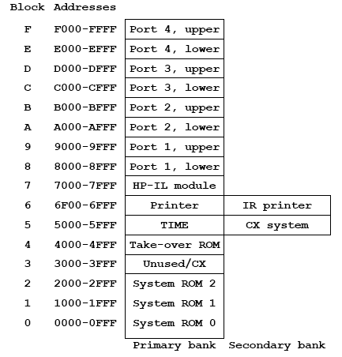
Loading the I/O Bus
EEE I/O Bus layout w/ multiple banks
Standard I/O Bus layout
State-of-the-Art: 16+24 pages = 160 kB
Standard OS Limit: 18 + 30 pg. = 192 kB
Theoretical Limit: 4 x 16 pgs. = 256 kB

Slide 22
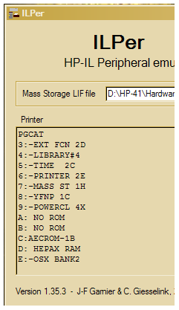









Interrogating the I/O Bus
System Bus Conflict Check ”CHKSYS”
automated upon “CALC_ON” event
Wholesale: I/O Bus Summary
PGCAT, ROMLST
Detail: Free, Used, Banked Report
FREE? , USED? , BANKED?, OSREV
Targeted: Auxiliary FATS anywhere?
AUXFAT , SFLNCH _
Action | OS/X | WARP | PowerCL
Auto Check | √
Manual Chk | √ | √ | √
Wholesale | √ | √ | √
Detail | √ |  | √
Targeted |  | √

Slide 23
Hyper-spacing sRAM (CL only)
Conceptual scheme of the different CL sRAM blocks
Uses can be Back-up or direct Access
Can also be used by SandMatrix functions (up to 50x50 Linear Systems)

Slide 24






Expanded Y-Registers (CL only)
1,024 Directly accessible Y-Regs (!)
3,072 available for Matrix Functions (!!)
STO/RCL Math, ISG/DSE, ALPHA, etc…
Supports IND, ST, RG, and combinations
All Programmable but not all meant for PRGM use
[XPMM]
Can you spot something different?
Extended Regs | Store | Recall | Other | X-Blocks
Y-Register From 0 to 1,023. Use EEX for the Fourth digit field. | YSTO _ _ _ | YRCL _ _ _ | YX<> _ _ _ | CLYRG
 | YST+ _ _ _ | YRC+ _ _ _ | YVEW _ _ _ | CLYRGX
 | YST- _ _ _ | YRC- _ _ _ | YDSE _ _ _ | YRGMOV
 | YST* _ _ _ | YRC* _ _ _ | YISG _ _ _ | YRGSWP
 | YST/ _ _ _ | YRC/ _ _ _ | YFINDX | ST<>YRG _ _ _
ALPHA | YAST _ _ _ | YARC _ _ _ |  | A<>YRG _ _ _

Slide 25
Y-Registers Applications ROM
Function | Description | Dependency | Type | Author | #
-Y-RGS_1B | Shows ‘RUNNING...” msg. | Lib#4 | MCode | Ángel Martin | 021.00
STVIEW | Stack View | Lib#4 | MCODE | Ángel Martin | 021.01
YCRYPT | Encrypts Page | CL, OSX3 | Hybrid | Ángel Martin | 021.02
"YDUMP | Dumps Standard Regs into Y- | XPMM, OSX | FOCAL | Ángel Martin | 021.03
"YINP | Inputs Y-Regs | XPMM, OSX | FOCAL | Ángel Martin | 021.04
"YOUT | Outputs Y-Regs | XPMM, OSX | FOCAL | Ángel Martin | 021.05
"YRAN | Enters Random values | XPMM, OSX | FOCAL | Ángel Martin | 021.06
"YSHFT | Selective Std, Reg copy | XPMM, OSX | FOCAL | Ángel Martin | 021.07
"YSORT | Sorts Y-Regs | XPMM | FOCAL | JM Baillard | 021.08
“YM>RM | Moves matrix to Standard Regs | XPMM, ADVTG | FOCAL | Ángel Martin | 021.09
“RM>YM | Moves matrix to Y-Regs | XPMM, ADVTG | FOCAL | Ángel Martin | 021.10
-YPPC_MTRX | Section Header | n/a | MCODE | Ángel Martin | 021.11
"QR | Quotient / Remainder | none | FOCAL | PPC | 021.12
"YMIO | Matrix I/O | XPMM | FOCAL | PPC | 021.13
"YRRM | Row Reduction Matrix | XPMM | FOCAL | PPC | 021.14
"YM1 | Interchange two rows | XPMM | FOCAL | PPC | 021.15
"YM2 | Multiply row by constant | XPMM | FOCAL | PPC | 021.16
"YM3 | Add multiple of row to another | XPMM | FOCAL | PPC | 021.17
"YM4 | Register address to ( i, j) | XPMM | FOCAL | PPC | 021.18
"YM5 | ( i, j) to Register address | XPMM | FOCAL | PPC | 021.19
"YS1 | Stack Sort | XPMM | FOCAL | PPC | 021.20
"YS2 | Small Register Sort | XPMM | FOCAL | PPC | 021.21
"YS3 | Large Register Sort | XPMM | FOCAL | PPC | 021.22
-YPPC_BLCK | Section Header | n/a | MCODE | Ángel Martin | 021.23
"YBC | Block Clear | XPMM | FOCAL | PPC | 021.24
"YBE | Block Exchange | XPMM | FOCAL | PPC | 021.25
"YBI | Block Increment | XPMM | FOCAL | PPC | 021.26
"YBM | Block Move | XPMM | FOCAL | PPC | 021.27
"YBR | Block Rotate | XPMM | FOCAL | PPC | 021.28
"YBV | Block View | XPMM | FOCAL | PPC | 021.29
"YBX | Block Extrema | XPMM | FOCAL | PPC | 021.30
"YB? | Block Statistics | XPMM | FOCAL | PPC | 021.31
"YDR | Delete Record | XPMM | FOCAL | PPC | 021.32
"YIR | Insert Record | XPMM | FOCAL | PPC | 021.33
"YMS | Memory to Stack | XPMM | FOCAL | PPC | 021.34
"YPR | Pack Registers | XPMM | FOCAL | PPC | 021.35
"YSM | Stack to Memory | XPMM | FOCAL | PPC | 021.36
"YUR | Unpack Registers | XPMM | FOCAL | PPC | 021.37
YDUMP, YSHFT – Complete & Selective Reg. Copy
YINPT, YOUPT – Y-Reg. Input/Output driver
YRAN, YSORT – Random and Sorted Y-Reg. Block
YM<>RM – Matrix Formats Exchange (JMB/ADV)
Y-REG versions of PPC Matrix & Block Routines
Y-REG versions of JMB_Matrix Programs
Function | Description | Dependency | Type | Author | #
-YJMB_MTRX | Section Header | n/a | MCODE | Ángel Martin | 021.38
"CRYMAT | Create Matrix from function | XPMM | FOCAL | JM Baillard | 021.39
M*M | Matrix Product | CL, Lib#4 | MCODE | Martin-Baillard | 021.40
MNORM | Matrix Norm | CL, Lib#4 | MCODE | Martin-Baillard | 021.41
TRACE | Matrix Trace | CL, Lib#4 | MCODE | Martin-Baillard | 021.42
"YDET | Determinant | XPMM | FOCAL | JM Baillard | 021.43
"YLS | Linear Systems | XPMM | FOCAL | JM Baillard | 021.44
"YLS1 | Linear Systems (variant) | XPMM | FOCAL | JM Baillard | 021.45
"YM- | Matrix Subtraction | XPMM | FOCAL | JM Baillard | 021.46
"YM+ | Matrix Addition | XPMM | FOCAL | JM Baillard | 021.47
"YM* | Matrix Product | XPMM | FOCAL | JM Baillard | 021.48
"YMCO | Matrix Copy | XPMM | FOCAL | JM Baillard | 021.49
"YMINV | Inverse Matrix | XPMM | FOCAL | JM Baillard | 021.50
"YMNORM | Matrix Norm | XPMM | FOCAL | JM Baillard | 021.51
"YMPL | Matrix Polynomial | XPMM | FOCAL | JM Baillard | 021.52
“YMRCL | Recall Matrix | XPMM, OSX3 | FOCAL | Ángel Martin | 021.53
"YMSTO | Store Matrix | XPMM, OSX3 | FOCAL | Ángel Martin | 021.54
"YRANM | Random (integers) Matrix | XPMM, TIMER | FOCAL | JM Baillard | 021.55
"YRNSYM | Symmetric RANM | XPMM, TIMER | FOCAL | JM Baillard | 021.56
"YTRACE | Matrix Trace | XPMM | FOCAL | JM Baillard | 021.57
"YTRN | Transpose Matrix | XMPP | FOCAL | JM Baillard | 021.58
"YTRN2 | Symmetric TRN | XPMM | FOCAL | JM Baillard | 021.59
[YRGA]
http://hp41programs.yolasite.com/matrixop.php,
http://hp41programs.yolasite.com/matrixmcode.php

Slide 26








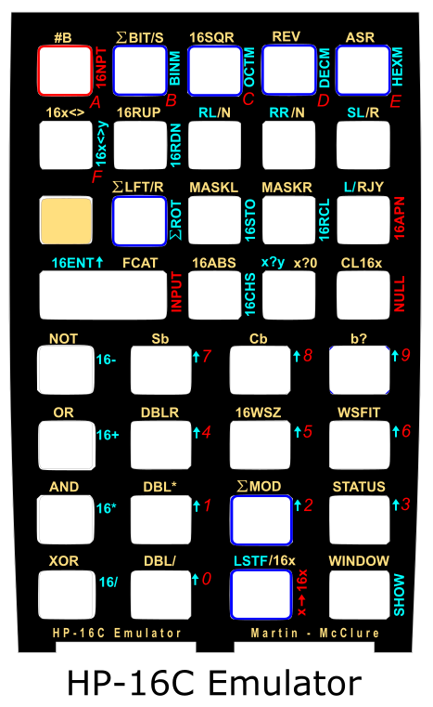
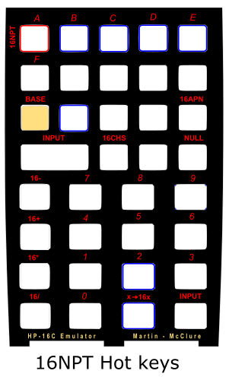
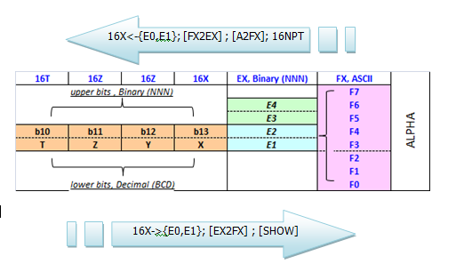
HP-16C Emulator Module
16C Register | Lower Bits | + | Upper Bits
16X | X |  | b13
16Y | Y |  | b12
16Z | Z |  | b11
16T | T |  | b10
16L | L |  | b14
[16CS]
ALPHA-based Data Input
64-bit full support
Superset of original HP-16C
Set of 24 Fns. enhanced
Set of 52 new Fns. Added
4k footprint, 4 banks
Automated Base Conversions

Slide 27









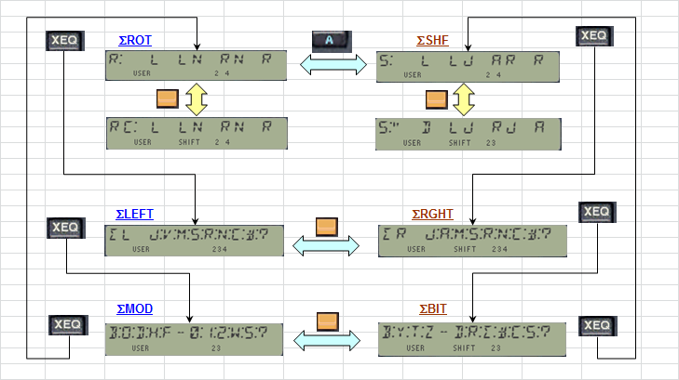
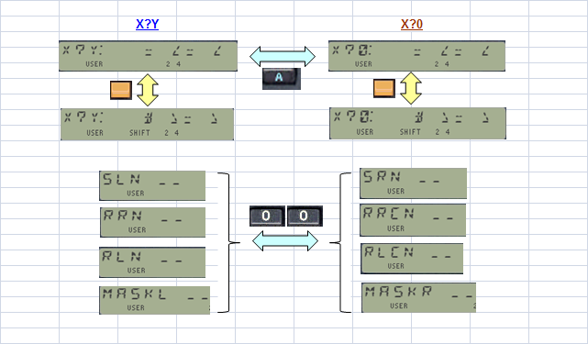
HP-16C Emulator Navigation Tips
Status Reports
Error Warnings
Training Wheels Mode
Interconnected Launchers
Comparison Tests Launchers
Mirrored Implementation

Slide 28

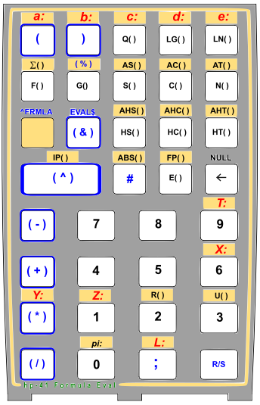









Formula Evaluation Module a.k.a “Giving TI a run for its money”
[FRML]
Formula Editor in ALPHA (24-char limit)
  Uses Buffer #6 (LIFO, 16-Registers in size)
Extended via Chained Evaluation
Can also use ASCII Files in Script Language
  GTO$, XEQ$, WHILE$
Full-expression Comparison Tests
Sums, Series & Products Evaluation
Stack Shuffle w/ Selective Clear
Includes ALPHA registers {M, N, O, P}
Can also clear them on the fly
$Variables
Rich, 13-digit Math function library
Direct Stack-Registers, π and Custom Variables
Utility Fns. For data register transfer
  STO$, X<>RG, SHFL “XYZTL”
Buffer id# | Buffer Reg | Type | Used for:
06 | b7 | Hex code | Operator-3
 | B6 | BCD value | 4th argument
 | b5 | Hex code | Operator-2
 | b4 | BCD value | 3rd argument
 | b3 | Hex code | Operator-1
 | b2 | BCD value | 2nd argument
 | b1 | BCD value | 1st argument
 | b0 | admin | Header

Slide 29
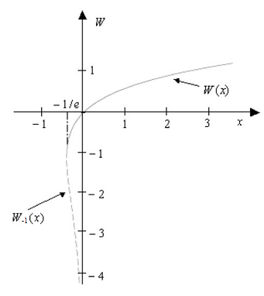


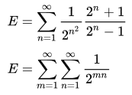


Formula Evaluation Module (Con’t)
Built-in Library of Applications (Upper 4k)
Accuracy holds to 8th/9th decimal point
Comparable runtimes with “RPN” approach
SV$ , ITG$ - Solve & Integrate
AGM$ - Arithmetic-Geometric Mean
2D & 3D Distances; Dot-Products
CL$ , FL$ - Ceiling & Floor Functions
QRT$ - Quadratic Equation Roots
LINE$ - Line equation thru 3 points
P4$ - Polynomial Evaluation (n<=4)
NFD$ - Normal Density Function
Rectangular <> Spherical
Julian <> Calendar Dates
Exponential function
Erdos-Borwein constant
GAM$ - Gamma Function
PSI$ - Digamma Function
LNG$ - LogGamma function
WL$ - Lambert function
Elliptic Integral 1st. Kind
Combinations & Permutations
Legendre Polynomials
Hermite’s Polynomials
Chebyshev’s Polyn. 1st & 2nd. Kind
Sine & Cosine Integral
Error Function
Bessel J integer order
Harmonic Number
Generalized Faulhaber’s Sum

Slide 30
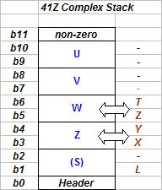
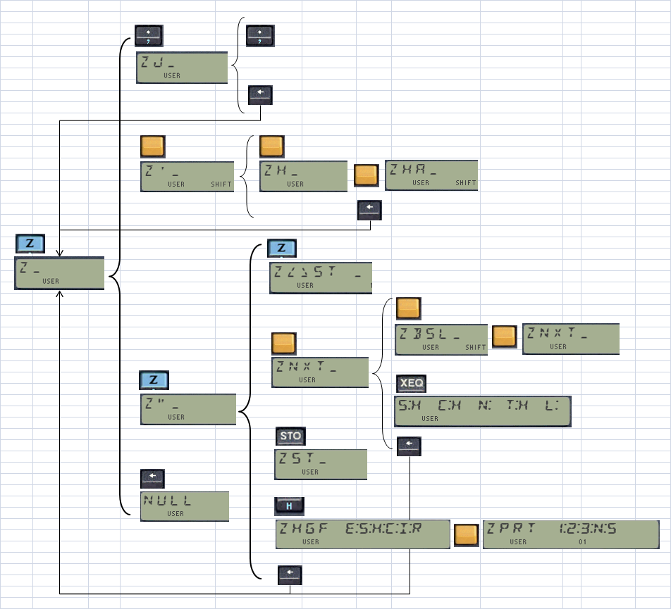






41Z Deluxe: The Complex Leviathan
Launchers, Drivers & Interactive U/I
Integer/Common factor display
Polar & Rectangular Modes
Natural Data Entry (real part first)
Automated 4-Level Complex Stack (buffer #8)
X-Mem Backup/Restore (file id #8)
ZSTO & ZRCL Math , Stack Functions
Sub-functions and LASTF support
Two pages, two banks each
ZKBRD
Z-pad
Z-Keys
Complex Keyboard
Page | Bank-1 | Bank-2
Upper Page XROM #04 | Main FAT w/ High-Level Math, Zvectors, | Function Tables and Launcher M-Code
Lower Page XROM #01 | Main and Aux-FATs, Z-stack | Lower-level Math Routines. M-Code.
Module | Launchers | LASTF Method
41Z | ZKBRD _ | Captures (sub)fnc id#
Deluxe | ZHGF, ZPRT, ZNEXT, ZBSL, ZHYP | Captures (sub)fnc id#
 | ZF$ _ | Captures fnc NAME
 | ZF# _ _ _ | Captures (sub)fnc id#
 | ZCAT (XEQ ’ ) | Captures (sub)fnc id#

Slide 31




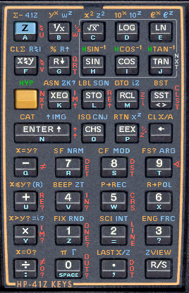
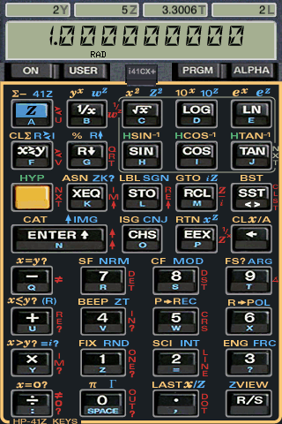
The 41Z Deluxe Leviathan
Complex Arithmetic
Elementary Functions
Complex Logarithms
2D-Vector Analogy
Trigonometry & Hyperbolics
Multi-valued functions Driver
Dual Means (AGM, GHM)
Arithmetic, Harmonic & Geometric Means
Polynomial Evaluation & Derivatives
Quadratic & Cubic Equation Roots
41Z Deluxe
41Z Diagnostics
Must be in next page
Admin and Troubleshoot
High-Level Math
Gamma, Digamma (Psi), LNGamma
ZETA, Lambert, InvGamma
Bessel 1st & 2nd kinds (!)
Sine, Cosine Integrals; error function (via ZHGF)
Many more Special functions (PolyLog, Lerch)
Complex Derivatives (ZDRV)
Complex Continued Fractions (ZCF2V)
Discrete Fourier Transform (DFT)
Solution to f(z)=0 (Secant, Newton, Halley)
Polynomial Roots - using ZDRV
Carlson & Elliptic Integrals

Slide 32

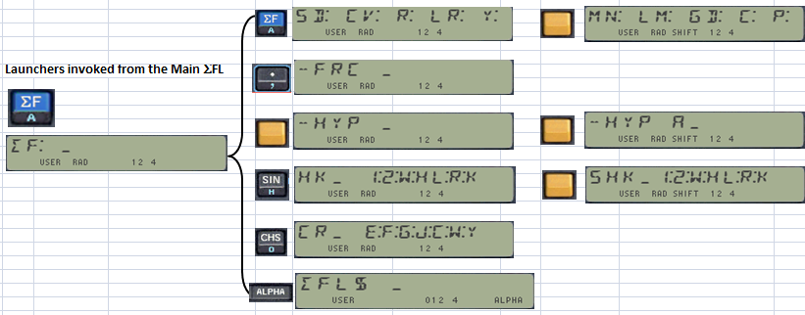





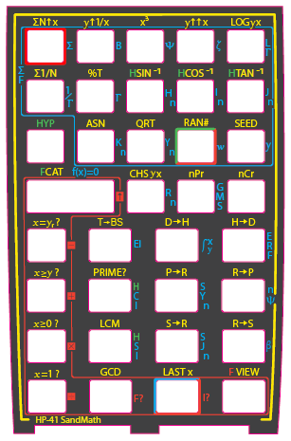
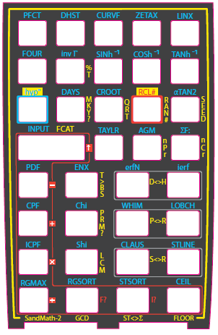
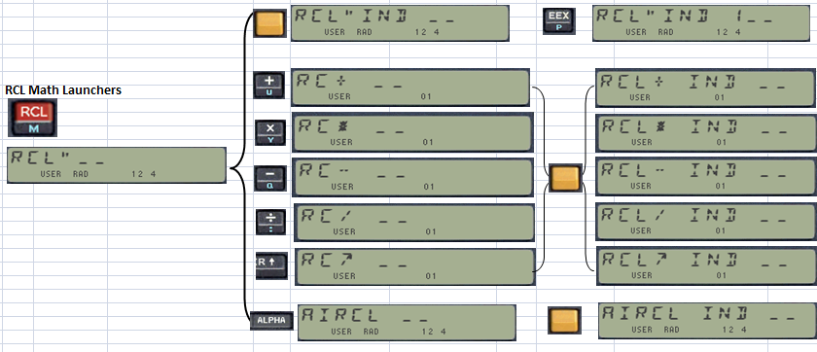
The SandMath Juggernaut
The Platform: Modes, Launchers, Functional Groups
Uses IO_SVC Polling Point

Slide 33
The SandMath Juggernaut (Con’t)
Fractions, Quadratic & Cubic Equations
Linear Regression, GCD, LCM
Hyperbolic Functions
Advantage’s Number Base conversions
Polynomial Evaluation & Derivatives
Orthogonal polynomials
Special Functions (Gamma, Bessel, Zeta)
Many, many more Special functions !
Carlson & Elliptic Integrals, AGM
Function 1st & 2nd Derivatives
Continued Fractions
SandMath
RCL Math, FIX ALL Mode
RCL Math
AECROM Curve Fitting
AEC Fitter
AEC Solvers
Triangle, Circle, SARR Solvers
Time Value of Money
TVM$
S&I
Advantage’s Solve & Integrate
Combinations & Permutations
Density & Cumulative Probability
Time-based Seed, Random numbers
Primes, Prime Factors, error function
Factorials, Primorials, Pochhamer, Apery, Kaprekar…
Taylor Coefficients & approximation
Chebyshev’s approximation
Fourier Series Coeffs. & Evaluation
Discrete Hartley (Symmetrical) Transform
Hypergeometric Functions galore

Slide 34
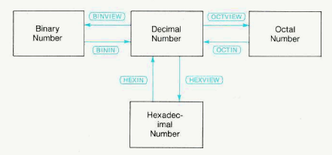







SandMath’s Base Conversions
Advantage’s HEX/OCT/BIN -In & -View
Ken Emery’s T>BS, Dedicated H<>D Utils
Automatic function selection depending on valid ranges
IL-Develop.
41-Advantage
Digit-Pack
SandMath
16C Emulator
Base | Function | Description | Author
 | BS>D _ _ | Base to Decimal, promting version | Ángel Martin
02 | BININ | “02” in prompt, then enter binary number | HP Co.
08 | OCTIN | “08” in prompt, then enter octal number | HP Co.
16 | HEXIN | “16” in prompt, then enter hex number | HP Co.
nn | BT | Any other, base in X and string in Alpha | George Eldridge
16 | D>H | Value in X | William Graham
16 | H>D | Hex String in Alpha | William Graham
 | D>BS _ _ | Decimal to Base, prompting version. | Ángel Martin
02 | BINVIEW | Value in X, “02” in prompt | HP Co.
08 | OCTVIEW | Value in X, “08” in prompt | HP Co.
16 | HEXVIEW | Value in X, “16” in prompt | HP Co.
nn | T>BS _ _ | Value in X, base in prompt | Ken Emery
-nn | TB | Base in Y, value in X (with negative sign) | George Eldridge
Page | Bank-1 | Bank-2 | Bank-3 | Bank-4
Upper | High-Level Math, Stats | Function Launchers, Curve Fitting | HP Advantage Solve & Integrate | AEC Program Generator
Lower | SandMath_44 | FRC, HYP, RCL# Math | TVM$, AECROM Geometry Solvers | Derivatives, Base Conversions
Base | IN/VIEW | D>H | T>BS
BIN | 1,023 1,111,111,111 | n/a | 4,095 111,111,111,111
OCT | 1,073,741,823 7,777,777,777 | n/a | 8,589,934,587 77,777,777,777
HEX | 4,294,967,295 FF,FFF,FFF | 9,999,999,999 254,0bE,3FF | 9 E10 1,4F4,6b0,400

Slide 35
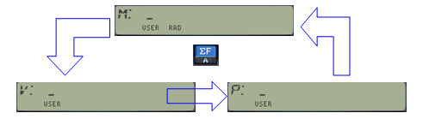
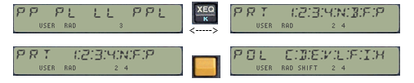
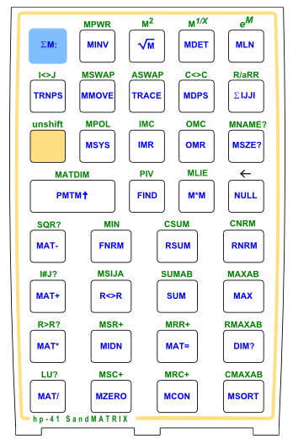
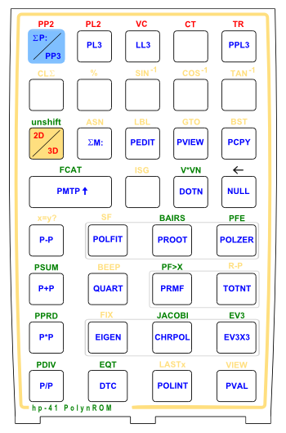
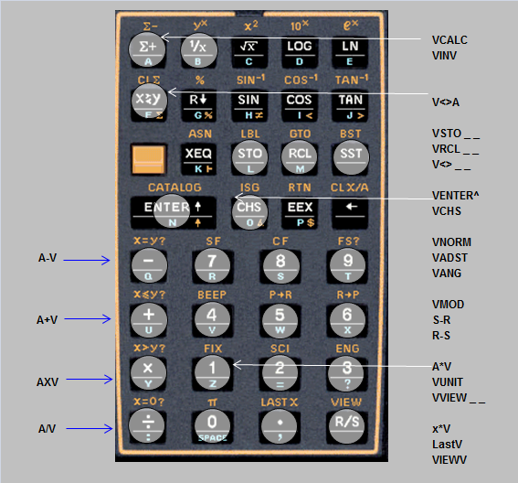





The SandMatrix Behemoth
Picks-up where the SandMath left things off:
Includes ALL functionality from Advantage Matrix
Adds new MCODE utilities (TRACE, MIDN, MZERO)
Adds Complex Matrix Transpose, Determinant, Minors
Features a Triple-Launcher: Matrix / Vectors / Polynomials
Plus a combined PolyRoots / Distances Launcher
New Matrix Editor (by rows)
<---->

Slide 36




The SandMatrix Behemoth (Con’t)
CCD Array Functions
Advantage’s Major Matrix Fns
Enhanced Matrix Editors
Real & Complex Matrix Minors
Complex Matrix Determinant (N<=5)
Complex Matrix Transpose
Matrix Pseudo-Inverse
Matrix Trace & Identity
Integer Powers and Roots
Matrix Exponential & Logarithm
Lie Product, Matrix Square Root
Pascal & Random Matrices
CL Y-Registers Support
Up to 50x50 Linear Sys
Main- and CL-Mem Matrix Catalogs
SandMatrix
Advtg. Matrix
Vector Calc.
Vector Calculator Functions
Major Vector Operations Driver
Coordinate Transformations
Polynomials
Polynomial and Derivatives Evaluation
Polynomial Arithmetic
Polynomial Roots, Quartic Equation
Orthogonal polynomials (Con’t)
Polynomial Fitting
Partial Fraction Expansion
Eigenvalues & Eigenvectors
Characteristic polynomial
Jacobi Method for Symmetrical Matrices
Prime Factors (Con’t)

Slide 37

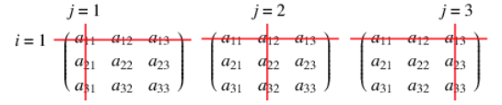



The SandMatrix on CL-steroids
Supersedes the Matrix group in [YRGA]
Main Memory
319 regs
Extended Memory
(600 regs)
CL RAM
(3,072 regs)

Slide 38
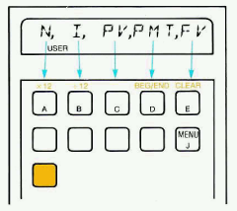






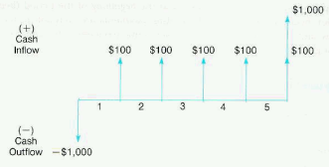
Time Value of Money TVM$ [TMVY]
From-the-scratch, MCODE HP-12C Equivalent
Direct Formula-driven variables for N, PV, FV, PMT (13-digit math)
Includes Advantage’s and PPC’s TVM Programs
Newton’s Method for interest rate I$ (13-digit math)
f ’ (i) = (PMT / i² ) * [ (1+i)^{-n} - 1 ] + n * [PMT (1 + ip)/i – FV ] * (1+i)^{-(n+1)}
i0 = [ abs( PV + n*PMT + FV) ]^{1/n}

Slide 39
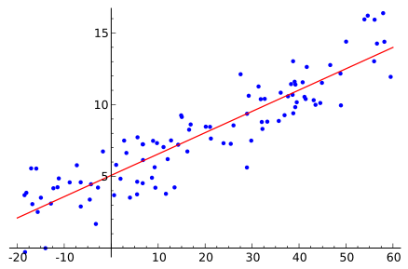
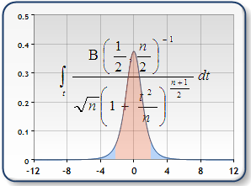
Extended Stats & Curve Fitting ROMS [XTAT,CURV]
Rounds-up SandMath functionality in stand-alone format:
Linear Regression functions
Primality Tests, Next Prime,
Combinations/Permutations
Summation Functions (Faulhaber’s et al)
Single and Duplex Means (AGM,…)
Ratios, GCD, LCM
Most popular Statistical Distributions
Probability Density Functions
Cumulative Probability
Stand-alone Curve Fitting Compendium:
AECROM Fitter
Advantage’s CFIT
Standard HP-41 / PPC’s “CV”
W. Kolb’s MCF
Polynomial Interpolation:
Aitken’s / Lagrange Methods
General Polynomial Best Fit
Linear Exponential Curve Fitting
Orthogonal Polynomials Fitting
Distribution | Density Function | Cumulative Probability | Driver
Normal | NRDF | NRCP | --
T-Student | TSDF | TSCP | TDIST
F-Snedecor | FSDF | FSCP | FDIST
Chi-Squared | C2DF | C2CP | CHI2
Poisson | PSDF | -- | POIS
Binomial | BNP | BNP+ | BIN

Slide 40
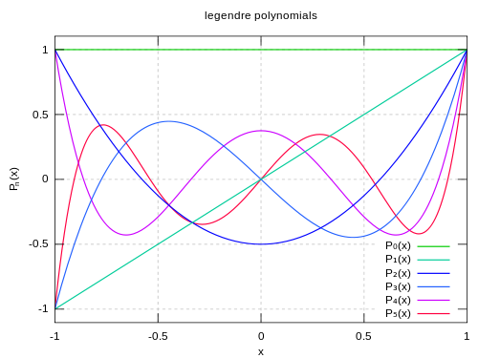
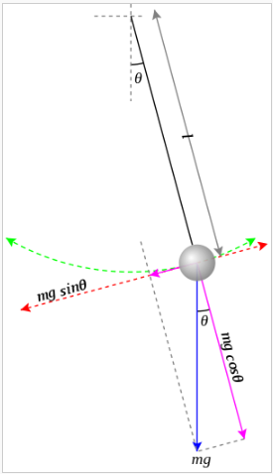
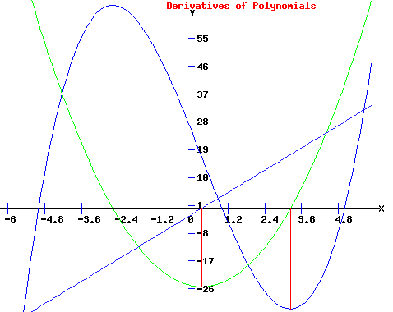
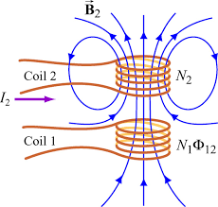


Elliptics and Orthogonal Pols ROM [EPTC]
XROM | Function | Description | Author
30,00 | -ELLIPTICS | Section Header | n/a
30,01 | AGM2 | Arithmetic-Geometric Mean | Ángel Martin
30,02 | AGM2 | Arithmetic-Geometric Mean | Ángel Martin
30,03 | "CEI" | Complete Elliptic Integrals | JM Baillard
30,04 | CRF | Carlson Integral 1st. Kind | JM Baillard
30,05 | CRFZ | CRF for complex arguments | JM Baillard
30,06 | "CRG" | Carlson integral 2nd. Kind | JM Baillard
30,07 | CRJ | Carlson Integral 3rd. Kind | JM Baillard
30,08 | CRJZ | CRJ for complex arguments | JM Baillard
30,09 | "EK" | Elliptic Int. 2nd. Order | Ángel Martin
30,10 | "ELI" | Incomplete Elliptic Integrals | JM Baillard
30,11 | ELIPE | Complete Elliptic Int. 2nd. Order | Ángel Martin
30,12 | ELIPF | Incomplete Elliptic Int. 1st. Order | Ángel Martin
30,13 | ELIPK | Complete Elliptic Int. 1st. Order | Ángel Martin
30,14 | GHM | Geometric-Harmonic Mean | Greg McClure
30,15 | "JEF" | Jacobi Elliptic Functions | JM Baillard
30,16 | "KK" | Elliptic Int. 1st. Order | Ángel Martin
30,17 | "LEI1" | Legendre Integral 1st. Kind | JM Baillard
30,18 | "LEI2" | Legendre Integral 2nd. Kind | JM Baillard
30,19 | "LEI3" | Legendre Integral 3rd. Kind | JM Baillard
30,20 | -EXAMPLES | Section Header | n/a
30,21 | -/+ | Calculates (y-x)/(y+x) | Ángel Martin
30,22 | ECC | Eccentricity | Ángel Martin
30.23 | ELP | Perimeter of Ellipse | Ángel Martin
30.24 | "MIND" | Mutual Inductance | Ángel Martin
30.25 | "SAE" | Surface Area of Ellipsoide | JM Baillard
30.26 | "PEND" | Pendulum period | Ángel Martin
30.27 | -JACOBIAN | Section Header | Ángel Martin
30.28 | ACOSH | Arc Hyperbolic Sine | Ángel Martin
30.29 | AJF | auxiliary for JEF | JM Baillard
30.30 | ASINH | Arc Hyperbolic Sine | Ángel Martin
30.31 | ATANH | Arc Hyperbolic Tangent | JM Baillard
30.32 | CBRT | Cubic Root | Ángel Martin
30.33 | COSH | Hyperbolic Cosine | Ángel Martin
30.34 | "P2" | Quadratic Equation | JM Baillard
30.35 | "P3" | Cubic Equation | JM Baillard
30.36 | SINH | Htyperbolic Sine | Ángel Martin
30.37 | TANH | Hyperbolic Tangent | JM Baillard
30.38 | THETA | Theta Functions | Ángel Martin
30.39 | "WEF" | Weierstrass Elliptic Function | Ángel Martin
30.40 | "WHIW" | Whittaker "W" function | Ángel Martin
XROM | Function | Description | Author
30.41 | -ORTHOPOL | Section Header | n/a
30.42 | "BELL" | Bell Polynomials | JM Baillard
30.43 | "BSSL" | Bessel Polynomials | JM Baillard
30.44 | CHBT | Chebyshev T(x) | Ángel Martin
30.45 | CHBU | Chebyshev U(x) | Ángel Martin
30.46 | "FIB" | Fibonacci Polynomials | Ángel Martin
30.47 | HMT | Hermite Polynomials | Ángel Martin
30.48 | LAG | Lagrange Polynomials | Ángel Martin
30.49 | LANX | Generalized Lagrange Polyn | Ángel Martin
30.50 | LEG | Legendre Polynomials | Ángel Martin
30.51 | "CBT+" | Chebyshev T(x) Coefficients | JM Baillard
30.51 | "CBU+" | Chebyshev U(x) Coefficients | JM Baillard
30.53 | "HMT+" | Hermite Polynomials Coeffs. | JM Baillard
30.54 | "JCP+" | Jacobi Polun. Coefficients | JM Baillard
30.55 | "LANX+" | Generalized Lagrange Polyn | JM Baillard
30.56 | "LEG+" | Legendre Polyn. Coefficients | JM Baillard
30.57 | "USP+" | Ultra-Spherical Polyn Coeffs. | JM Baillard
30.58 | dPL | 1st. Derivative polynomial | Ángel Martin
30.59 | d2PL | 2nd. Derivative Polynomial | Ángel Martin
30.60 | DTC | Delete Tiny Coeffs | Ángel Martin
30.61 | ITPL | Integral of Polynomial | Ángel Martin
30.62 | PDEG | Polyn Degree | Ángel Martin
30.63 | PVAL | Polyn Evaluation | Ángel Martin
Complete Integrals | FOCAL Routine | MCODE Function
First kind | “KK” | ELIPK
Second kind | “EK” | ELIPE
Third kind | n/a | n/a
All at once | “CEI”

Slide 41








Sums & Areas ROM [SERI]
XROM | Function | Description | Author
18,00 | -SERIES 1A | Section header | Ángel Martin
18,01 | CHSYX | Sign Change of Y by X: Y*(-1)^X | Ángel Martin
18,02 | NCK | Combinations of N in sets of K | Ángel Martin
18,03 | NPK | Permutations of N in sets of K | Ángel Martin
18,04 | Σ0 | Sum of mantissa digits | PoulKaarup
18,05 | Σ1 | Sum of first N integers | PoulKaarup
18,06 | Σ1/N | Harmonic Numbers | Ángel Martin
18,07 | Σ2 | Sum of Squares of Numbers | PoulKaarup
18,08 | Σ3 | Sum of Cubes of Numbers | PoulKaarup
18,09 | ΣN^X | Generalized Faulhaber’s Sum | Ángel Martin
18,10 | ΣUM | Single Series Sum (Explicit) | Ángel Martin
18,11 | ΣΣUM | Double Series Sum (Explicit) | Ángel Martin
18,12 | ΣΣΣUM | Triple Series Sum (Explicit) | Ángel Martin
18,13 | "ΣUME | Euler Transformation | JM Baillard
18,14 | "ΣUMR” | Single Series Sum (Iterative) | JM Baillard
18,15 | “NΣUM0” | Multiple Series Sum (Explicit) | JM Baillard
18,16 | FNRM | Finite Nested Radical order m | Ángel Martin
18,17 | INRM | Infinite Nested Radical order m | Ángel Martin
18,18 | PRODX | Infinite Product w. argument | Ángel Martin
18,19 | XQRTN | XQ Return to MCODE | Martin-McClure
18,20 | X#YR? | Compares rounded X and Y | Ángel Martin
18,21 | "NS” | Example for NΣUM0 | Martin-Baillard
18,22 | "S” | Example for ΣUM | Martin-Baillard
18.23 | "SE” | Example for ΣUME | Martin-Baillard
18.24 | "SR” | Example for ΣUMR | Martin-Baillard
18.25 | "SS” | Example for ΣΣUM | Martin-Baillard
18.26 | "SSS” | Example for ΣΣΣUM | Martin-Baillard
18.27 | “SIG1 | Single Series Sum (Explicit) | JM Baillard
18.28 | “SIG2 | Double Series Sum (Explicit) | JM Baillard
18.29 | “SIG3 | Triple Series Sum (Explicit) | JM Baillard
18.30 | STK>PT | Stack to Pointers | Ángel Martin
18.31 | PT>STK | Pointers to Stack | Ángel Martin
XROM | Function | Description | Author
18.32 | -AREAS_1B | Section Header | Ángel Martin
18.33 | AINT | ALPHA Integer Part | Fritz Ferwerda
18.34 | BRHM | Brhamagupta formula | Ángel Martin
18.35 | CIRCLE | Circle through three points | Ángel Martin
18.36 | DIAG | Diagonal formula | JM Baillard
18.37 | HERON | Heron formula | Ángel Martin
18.38 | RPG1 | Regular Polygon from sides | PoulKaarup
18.39 | RPG2 | Regular polygon from circle | PoulKaarup
18.40 | "3PNTS” | Driver for CIRCLE/Areas | Ángel Martin
18.41 | "CCPA” | Complex Cyclic Polygon Area | JM Baillard
18.42 | "CCPA+” | Driver for CCPA | Ángel Martin
18.43 | "CPLA” | Complex Cyclic Polygon Area | JM Baillard
18.44 | "CPLA+” | Driver for CPLA | Ángel Martin
18.45 | "CPLD” | Complex Cyclic Polyg. Diagonals | JM Baillard
18.46 | "CPLD+ | Driver for CPLD | Ángel Martin
18.47 | “PGA | Polygon Areas | PoulKaarup
18.48 | "STLA” | Star Polygon Area | JM Baillard
18.49 | "STLA+” | Driver for STLA | Ángel Martin
18.50 | “#” | Auxiliary for SOLVE | Ángel Martin
18.51 | “TRIA | Driver for ABC | Ángel Martin
18.51 | “ABC | Triangle Solver | JM Baillard
18.53 | “TRIH | Driver for HABC | Ángel Martin
18.54 | “HABC | Hyperbolic Triangles | JM Baillard
18.55 | “TRIS | Driver for SABC | Ángel Martin
18.56 | “SABC | Spherical Triangles | JM Baillard
18.57 | “OUT | Output Registers | Ángel Martin
18.58 | SINH | Hyperbolic Sine | Ángel Martin
18.59 | COSH | Hyperbolic Cosine | Ángel Martin
18.60 | TANH | Hyperbolic Tangent | Ángel Martin
18.61 | ASINH | Hyperbolic ASIN | Ángel Martin
18.62 | ACOSH | Hyperbolic ACOS | Ángel Martin
18.63 | ATANH | Hyperbolic ATAN | Ángel Martin

Slide 42




Sand² -Math and Solve & Integrate ROMS
[ADVG, SIHP]
Complex Matrix Minors
Complex Determinants w/ Minors
Complex Matrix Trace
Complex Matrix Transpose
Colum Data Sort
Least Squares 2nd Order
Example | Description | Using Program | Application Type | Dimension
2DF1 | Integrand example1 | 2DITG | 2D Integration | Simple
2DF2 | Integrand example2 | 2DITG | 2D Integration | Simple
2DF3 | Integrand example3 | 2DITG | 2D Integration | Simple
F1XY | Integrand example1 | FITG2 | 2D Integration | Recursive
F2XY | Integrand example2 | FITG2 | 2D Integration | Recursive
F1, F2 | Operands example1 | FRT2 | 2-equation System, | Recursive
G1, G2 | Operands example2 | FRT2 | 2-equation System | Recursive
CI | Cosine Integral | FINTG | Single Integration | Simple
SI | Sine Integral | FINTG | Single Integration | Simple
ERF | Error Function | FINTG | Single Integration | Simple
FOURN | Fourier Coeffs. | FINTG | Single Integration | Simple
Q-1 | Inverse Probability | FROOT, FINTG | Roots of integral | Nested
JNX | Bessel Function J | FINTG | Single Integration | Simple
JITX | Integral Bessel J | FITG2 | 2D Integration | Recursive
JZRN | Zeros Bessel J | FROOT, FINTG | Roots of integral | Nested
Complex Step Real-Derivative (ZNWT)
Newton’s & Halley’s Method using DERV
Bessel J via Continued Fractions (large arguments)
Cubic Spline Interpolation
Curve Fitting w/ Akima’s Method
Harmonic Determinants
Anti-Identity Matrices
Over-Conditioned Systems
Non-Linear Equation Systems
2D Integration (Recursive INTEG)
2-Non-Linear Equation System (Recursive SOLVE)
http://www.hpmuseum.org/forum/thread-6311.html?highlight=recursive

Slide 43









Non-linear Systems ROM [NONL]
01 | Non-Linear Systems | Driver Prog | Math Routine | Aux Routines | Examples
 | 2 Equations | 2NLS+ | 2NL | n/a | FG
 | 3 Equations | 3NLS+ | 3NL | n/a | FGH
 | n-Equations | NNLS+ | NLS, LS | FIN, XIN, XOUT | F1, F2, F3
 | n-Equations (Advtg) | NLSYS | MSYS | FIN, XIN, XOUT | F1, F2, F3
n = 0 y(x) = 1 - x²/6
n = 1 y(x) = (sinx)/x
n = 5 y(x) = ( 1+x²/3) ^{-1/2}
02 | Numerical Analysis | Driver Prog | Math Routine | Examples
 | Laplace Eq. | LAP+ | LAP | VLX, VX0, CLX
 | Poisson Eq. | POIS+ | POIS | UX0, UY0, UXL, ULY, FXY
 | Diffusion Eq. | DFSN+ | DFSN | aXT, bXT, cXT, FX0, F0T, FLT
03 | Differential Equations | Driver Prog | Math Routine | Examples
 | Second Order | 2DFEQ | 2RGK | d2/dX2 (Lane-Emden)
 | Third Order | 3DFEQ | 3RGK | d3/dX3
 | Nth. Order | 4DFEQ | NRGK | d5/dX5
04 | Successive Approx. | Driver Prog | Math Routine | Examples
 | Real | XSAM | FXN | X=, Y=, Z=
 | Complex | ZSAM | FZN | Z1=, Z2=

Slide 44















From SOLVE to Solver: Equation Libraries
From: f(x)=0 to: f(a,b,c,d,e)=0
Up to five variables to solve for. (at least 3)
Mapped to local Labels [A]-[E] - and {R01–R05}
FOCAL driver I/O, UF-22 controlled known/unknown
Other Constants prompted separately
Two versions available:
  [ISOL] “Interchangeable Solutions”, uses FROOT
  [EQLB] “Formula-Evaluation” based, uses “SLV$”
  ASCII File includes all information. Navigation keys: PREV, NEXT, S&R
  User can add own custom equations

Slide 45


Equation Libraries in Detail
# | Eq. NAME | Description | CF00 <- Options -> SF00
1 | "<)RLC | Delay angle RLC | Serial RLC / Parallel RLC
2 | "BERN-A | Bernoulli w/Areas
3 | "BERN-V | Bernoulli w/Velocities
4 | "CATNRY | Catenary Equation | d = H.[1 - (1/cosh(V/2a))]
5 | "F=Ma | Force Equation
6 | "F=MM/R2 | Gravitation
7 | "HEATX | Heat Exchangers | Counterflow / Parallel Flow
8 | "HERON | Heron Formula
9 | "ISENT | Isentropic Flow
10 | "KEPLR | Kepler Equation
11 | "MPAD | Michell Pad
12 | "MVT | Linear Movement | x = x0 + v.t + 1/2 a.t^2
13 | "ORBIT | Orbital Trajectory | e = sqrt{1+[Vo^2 - 2g(Ro2/r)][r.Vo.cos a / g.Ro]^2}
14 | "PRJT-D | Projectile Displacement | X-Coordinate / Y-Coordinate
15 | "PRJT-V | Projectile Velocity | X-Coordinate / Y-Coordinate
16 | "PV=ZNT | Ideal Gas EOS
17 | "R1+R2 | Parallel Resistors
18 | "REDLCH | Redlich-Kwong EOS
19 | "RFLC | Resonance Frequency RLC
20 | "RPM=TP | Torque Equation
21 | "SRL-AC | Serial RL AC Control
22 | "TVM | Time Value of Money | Begin mode / End mode
23 | "V=IR | Ohm's Law
24 | "VMOD | Vector Module
25 | "VWAALS | Van-der Waals EOS
26 | "Y=aX+b | Linear Equation | P1 = a.x + b
27 | "Y=PX2 | Quadratic Equation | P2 = a0 + a1.x + a2.x^2
28 | "Y=PX3 | Cubic Equation | P3 = 1 + a1.x + a2.x^2 + a3.x^3
# | NAME | Description | Equation
1 | LINEAR | Line Equation | Y = Ax + B
2 | QUADRATIC | Quadratic Equation | Y = A.x^2 + .Bx + C
3 | CUBIC | Cubic Equation | Y = A.x^3 + B.X^2 + C.x + D
4 | 4TH ORDER | Quartic Ecuation
5 | POSROOT | Positive Root | x1 = (-B + sqrt(B^2 - 4A.C))/ 2A
6 | NEGROOT | Negative Root | x2 = (-B - sqrt(B^2 - 4A.C))/ 2A
7 | OHMS LAW | Ohm's Law | E = I.R
8 | PARALLEL R | Parallel Resistors | 1/R1 = 1/R1 + 1/R2
9 | RLC FREQ | RLC Oscillator | F0 = 1/sqrt(L.C)
10 | GAS EQUATION | Perfect Gas Equation | P.V = N.R.T
11 | LIN. MOTION | Linear Motion | X = V.T + 1/2 A.T^2
12 | NEWTONS LAW | Newton's Law | F = G. M1.M2/R^2
13 | INTEREST | Compound Interest
14 | +TVM END MODE | Extended version-1
15 | +TVM BEGIN MODE | Extended version-2
16 | …add your own equations here…
Formula-Eval Based:
FROOT Based:

Slide 46





Science & Engineering Modules (my fav’s)
ETSII Collection
[ETS3, ETS4, ETS5]
Dynamic Balancing
Holzer Method
Heat Transfer
Heat Exchangers
Binary Mixes
Liquefaction Cycles
Refrigerant Gases
Psychrometric Props.
Water Hammer
Joukowski Airfoils
Pump Association
Pipe Network Analysis
ETSII Collection – Con’t [ETS9, FFEE]
Two-Port Networks
Swing Equation
Power-Flow Equations
AC Regulator Design
Electric Circuits
Backwards LAP
Logical Networks
Frequency Response
Transfer Functions
Physics & Earth:
ELIX Orbital Mechanics
GRVI Gravity & Time
NBOD N-Body Problem
TIDW Tides ROM
PRTW US Ports
NONL Non-Linear ROM
EEFD EE Filters Design
LPLC Laplace Transforms
ISOL Interch. Solutions
INDO Indoor Lighting
LTLN Geodetics ROM
STEQ Steam Properties

Slide 47



Orbital Mechanics 101
Function | Description | Input / Output
-ELLIP APPS | Section Header | n/a
BRHM | Area of Cyclic Quadrilateral | Data in R01-R04
CIRCLE | Circle through three points | P1, P2, P3 in Registers R01-R06
"ECS+" | Driver for ECS | Prompts for values
ECS | Elliptical Central Sector | {a,b,e} in R00-R02, a in X
EFS- | Ellliptical Left Focal Sector | {a,b,e} in R00-R02, a,b in R03-04
“EFS+“ | Elliptical Right Focal Sector | {a,b,e} in R00-R02, a,b in R03-04
HERON | Area of Triangle from sides | Data in X,Y,Z
“K2-“ | Kepler 2nd. Law – Left Sector | Prompts for values
“K2+“ | Kepler 2nd. Law – Right Sector | Prompts for values
"LCS“ | Central sector Arc Length | Prompts for values
"LF+" | Right Focal sector Arc Length | Prompts for values
RAMA2 | Ramanujan’s 2nd. Approx. | a,b, in Y,X
TOF | Time of Flight | (T, e, q) in { Z,Y,X}
ZELIP1 | Complex Elliptic Intg. 1st. kind | z in (Z,Y), m in X
ZELIP2 | Complex Elliptic Intg. 2nd. kind | z in (Z,Y), m in X
-ORBITS 101 | Section Header | n/a
E>M | Eccentric to Mean anomaly | (e, E) in Y,X
E>T | Eccentric to True Anomaly | (e, E) in Y, X
M>E | Mean to Eccentric anomaly | (e, M) in Y,X
T>E | True to Eccentric Anomaly | (e, T) in Y,X
“ORBIT“ | Delta-V Orbit Simulator | Under program control
“TA<T>“ | True Anomaly via Kepler | New Position w/Kepler equation
“TA+“ | True Anomaly Direct Mode (+) | New Position using Right sectors
“TA-“ | True Anomaly Direct Mode (-) | New Position using Left sectors
“<)T“ | Subroutine for Solve | Under program control
“V<R>“ | Velocity “Vis Vivas“ | Velocity at distance – Left focus
“VR+“ | Velocity at Position R+ | Velocity at distance - right focus
“VR-“ | Velocity at Position R- | Velocity at distance - Left focus
T(μ) | Period from Gravitational data | Mass in Y, semi-major axis in X
μ1/2 | Gravitational Parameter | Period in Y, semi-major in X
-AUX FNS | Section Header | Doubles as QROUT
<)C-R | Central angle to Radius | {a,b,e} in R00-R02, a in X
<)C-XY | Central angle to coordinates | {a,b,e} in R00-R02, a in X
<)C0+ | Central angle for Focal 90° | (a b,e) in R00-R02. Lifts stack
<)C>F | Central to Focal angle | {a,b,e} in R00-R02, a in X
<)F>C | Focal to Central angle | {a,b,e} in R00-R02, a in X
<)F0+ | Right focal angle at x=0 | (a,b,e) in R00-R02. Lifts stack
<)F0- | Left Focal angle at x=0 | (a,b,e) in R00-R02. Lifts stack
<)F>R- | Left Focal angle to radius | {a,b,e} in R00-R02, a in X
<)F>R+ | Right focal angle to radius | {a,b,e} in R00-R02, a in X
“?ab“ | Prompts for semi-axis | New value or R/S for current
“?<)-“ | Prompts for left-angles | New value or R/S for current
“?<)+“ | Prompts for right-angles | New value or R/S for current
“?P“ | Prompts for Period | New value or R/S for current
QROOT | Quadratic Eqn. Roots | c2, c1, c0 in Z,Y,X
V(X) | Velocity at abscissa X | Period in Y, abscissa in X
Ellipse Central and Focal Sector Areas and Arc Lengths
Elliptic Integrals and other Geometry Utils
Orbital Position Determination & Time of Flight
- Kepler Equation and Direct approaches.
Orbital Velocity Determination:
- Conservation of Energy, Angular Momentum
Solar System Orbits & Gravitational parameters
Delta-V orbit Simulator (HP Solution Book)
Orbit Phasing, Co-Orbital & Co-Planar rendez-vous
-SOLAR SYS | Section Header | Doubles as ZOUT
EARTH | Planet orbital data | Puts data in R00-R02 & R06
JUPITER | Planet orbital data | Puts data in R00-R02 & R06
MARS | Planet orbital data | Puts data in R00-R02 & R06
MERCURY | Planet orbital data | Puts data in R00-R02 & R06
MOON | Satellite orbital data | Puts data in R00-R02 & R06
NEPTUNE | Planet orbital data | Puts data in R00-R02 & R06
PLUTO | Planet orbital data | Puts data in R00-R02 & R06
SATURN | Planet orbital data | Puts data in R00-R02 & R06
URANUS | Planet orbital data | Puts data in R00-R02 & R06
VENUS | Planet orbital data | Puts data in R00-R02 & R06
+VH12 | Hohmann Transfers v1 & v2 | M, R1, R2 in (Z,Y,X)
+VB123 | Bi-Elliptic Transfer V1, V2. V3 | (M, r1, r2, rb) in {T,Z,Y,X}
+VEa12 | Elliptic Apogee Transfers V12 | (r1, r2, r3, r4,M) in Stack & LastX
+VEb12 | Elliptic Perigee Transfers V12 | (r1, r2, r3, r4,M) in Stack & LastX
“CORV“ | Co-Orbital Rendezvous | Prompts for Data
“CPRV“ | Co-Planar Rendezvous | Prompts for Data

Slide 48











Odd Balls and Nerdies (gotta love them!)
Path-finding in Metro Networks [METX]
5MAD Metro Madrid
5PAR Paris Metro
5LON London Tube
5UBH Berlin U-Bahn
NYSB NYC Subway
Three Originals:
SUD1 Sudoku & Sounds
CITY Country Capitals
WORD Dictionary
English<>Spanish

Slide 49







Path-finding in Subway Networks
Input Begin & End stations by name
…..
Individual Station details and From/To Transfer Info
Consolidated function launchers (connected)
Key | LEVEL 0:1:2:3;X:^ | Key | XFER +:-:*:C:H:T:?
[ 0 ] | LEVEL0 | [ + ] | NEXTX
[ 1 ] | LEVEL1 | [ - ] | PREVX
[ 2 ] | LEVEL2 | [ * ] | NEARX
[ 3 ] | LEVEL3 | [ C ] | CHANGE
[ X ] | XPLORE | [ H ] | LHEAD
[ENTER] | ^PATH | [ T ] | LTAIL
[?] | XPLORE | [ ? ] | ?MAP
[SHIFT] | XFER _ | [SHIFT] | LEVEL _
[ALPHA] | STNAME | [ALPHA] | STNAME
[PRGM] | STINFO | [PRGM] | STINFO

Slide 50



Words and Cities in detail
Enumeration by types & kinds
Tilde & special chars on LCD
“I’m feeling Lucky” selection
Function | Description | Input
-ENGL>SPAN | Section Header | n/a
SPANISH | Translates Word to Spanish | English word in ALPHA
NOUNS | Enumerates English Nouns | none
VERBS | Enumerates English Verbs | none
OTHER | Enumerates other English words | none
CHANCE | Retrieves one word at random | (time from Time Module)
WORD _ _ _ | Retrieves a word by its index | Index# in Prompt
“WLIST” | Lists ALL English words | none
-ESPA>INGL | Section Header | n/a
INGLES | Translates Word to English | Spanish word in ALPHA
NOMBRES | Enumerates Spanish Nouns | None
VERBOS | Enumerates Spanish Verbs | None
RESTO | Retrieves other Spanish words | None
PALABRA _ _ _ | Retrieves a word by its index | Index# in prompt
AZAR | Retrieves one word at random | (time from Time Module)
“LISTAP” | Lists ALL Spanish words | none
-DC TOOLS | Section Header | n/a
CLWAIT | Like PAUSE for the CL model | none
DTOA | Utility to write LCD to ALPHA | Text in LCD
“HANGM” | Hangman word-guessing game | Word in Alpha
INDICE | Gets index# in Spanish Table | Spanish word in ALPHA
RNG | Random Number Generator | Time from Time Module
WINDEX | Gets index# in English Table | English word in Alpha
Function | Description | Input
-COUNTRIES | Section Header | n/a
COUNTRY | Finds Country for Capital | City name in ALPHA
NEWORLD | New World Countries | none
EUROPE | European Countries | none
RESTOW | “‘Rest of the World” Countries | none
ANYLND | Retrieves one country at random | (time from Time Module)
LAND _ _ _ | Retrieves a country by its index | Index# in Prompt
“RLIST” | Lists ALL Countries | none
AREV | Utility to Reverse ALPHA strings | Text in ALPHA
-CAPITALS | Section Header | n/a
CAPITAL | Finds Capital for Country | Country Name in ALPHA
AMERY | Enumerates New World Cities | None
EUROY | Enumerates European Cities | None
OTHER | Lists “Rest of World” Cities | None
CITY _ _ _ | Retrieves capital by its index | Index# in prompt
ANYCTY | Retrieves capital at random | (time from Time Module)
“LISTAP” | Lists ALL capital cities | none
RNG | Random Number Generator | Time from Time Module

Slide 51





R&R: Fun Stuff & Playground
Ain’t such a thing as too much fun
CHES CH136 Chess
QUEN Queens NxN
RUBK Rubik’s Cube
MAZZ Mazes
PPOK Poker ROM
FUNS Fun_Stuff
AGAM Action Games
GRMK Sammlung Book
GSWP Swap_Games
RGME Raw_Games
4WIN Connect Four
ZONE Game_Zone
MONO Monopoly
HORO Horoscope
MAHJ Mah-Jong Score
Adventure Games:
TREK/GAMX/ADV1
Trekkies
Dungeon
Explore
The Caves
Ghost Town
Black Tower
Tower of Skelos
Swords & Sorcery
Dungeon of Death
Terror Dam
Treasure Quest
French Adventure

Slide 52



Office Informatics & Other Miscellaneous
SHTZ Spreadsheet & SIMPLEX
RCSN Recursion & MODMath
BASI BASIC & FIFTH
PSDB PASCAL & DataBanks
CRTO Cryptography
UCLN User Calendar
PPC9 PPC Statistics
GRAW PPC RAW Collection
TEDR Text Editors
DIGT Digit-Pack
From Swap Disks:
FSSY Focal Disassembly
SWP2 Swap Disks Routines
SWP3 Swap Math
GSWP Swap Games
AECROM Derivatives:
AEC3 13-digit AECROM
PROG Program Generation
GSLV Geometric Solvers
HEPAX Derivatives:
HPX2 CL Extended HEPAX
HDIS Hepax Disassembler
HTAB Periodic Table
HP-IL Related:
DEV2 HPIL-Development+
ILBF IL-Buffer ROM
MASS Extended Mass Storage
GRF1 Grafik m.d. HP41 Plotter

Slide 53
Adapted Books & Literature
The FOCAL Factory never sleeps…
PPCU PPC Manual Examples
UCCD CCD Manual Examples
CCDA CCD Advanced Apps
2SWP SWAP Disks Routines
3SWP SAWP Math Programs
WWDB Wickes, Wlodeck, Dearing
JARR Keith Jarret SP / XF
MCCK Alan McCormak
KRSS Karl-Heinz Krauss
KRGM G. Kruse & KH Gossman
REGU Control Systems
VIEW HP-41 in der Praxis
QMTH Prisma-Math
PAPZ Published Papers
UPLM UPL(E) Programs
LUIZ,VONK User’s Collections
**** All HP Solution Books
Jean-Marc Baillard’s
ASTT ASTRO ROM
BSSL BESSEL ROM
DIFF Differential Equations
FRID Fractional Intgr./Diff.
GMTY Geometry_11
INTG Integrator ROM
HCPL Hyper-Complex ROM
JMBC JMB_Calendar
JMAT JMB_Math
JMTX JMB_Matrix
NTHY Number Theory
POLY Polynomial ROM
QUAT Quaternions
SPEC Spectral Analysis
KNGT JMB_Knight’s Tour

Slide 54

Acknowledgements (a.k.a. the usual suspects…)
“Standing on the Shoulders of Giants”
Obviously to HP “of yore”, for the HP-41 System and its fabulous OS MCODE
W&W GmbH, VM Electronics, Redshift s/w – publishers of CCD Module, HEPAX & AECROM
Wilson “Bill” Holes and Nelson F. Crowle, head & heart of the AECROM – “Viva Las Vegas!”
Doug Wilder, author of ROMED, Jump Distances and GOSUB/GOTO Decoders
Håkan Thörngren, author of RAMED & several XM-Utils. Takk!
Greg McClure co-authored the 16C Emulator and Formula Evaluation Modules,
true “partner-in-crime” for numerous MCODE projects and explorations
David Ingebretsen, program Sponsor and advisor
Jean-Marc Baillard provided inextinguishable Math expertise and co-authored Math ROMs
Mark Fleming authored the Equation Library (Formula-Eval version)
Monte Dalrymple for creating the fabulous 41CL board
Diego Díaz, Meindert Kuipers, Jean-François Garnier – guys, your gizmos rock!
Sylvain Côté, always glad to share his encyclopedic knowledge
Poul Kaarup, author of the PK-Collection w/ innovative apps
… and many, many others that would take too long to include!

Slide 55
Appendix: Suggested CL Configurations
Pg# | #0: Super User |  | #1: Math Machine |  | #2: Scientist’s |  | #3: Informatics |  | #4: HP-IL
 | IMDB | XROM-Name | IMDB | XROM-Name | IMDB | XROM-Name | IMDB | XROM-Name | IMDB | XROM-Name
0-2 | OS41 | CX’s O/S | OS41 | CX’s O/S | OS41 | CX’s O/S | OS41 | CX’s O/S | OS41 | CX’s O/S
3 | XFN5 | 25-CL-X/Functions | XFN5 | 25-CL-X/Functions | XFN5 | 25-CL-X/Functions | XFN5 | 25-CL-X/Functions | XFN5 | 25-CL-X/Functions
4 | 4LIB | Library#4 | 4LIB | Library#4 | 4LIB | Library#4 | 4LIB | Library#4 | 4LIB | Library#4
5 | TMOD | 26-CL-Time Mod. | TMOD | 26-CL-Time Mod. | TMOD | 26-CL-Time Mod. | TMOD | 26-CL-Time Mod. | TMOD | 26-CL-Time Mod.
6 | OSX3 | 05-AMC_OS/X | OSX3 | 05-AMC_OS/X | OSX3 | 05-AMC_OS/X | OSX3 | 05-AMC_OS/X | HPIL | 29/28 Printer / Mass Storage
7 | YFNX | 15-Y-Fncs_Extrm. | YFNX | 15-Y-Fncs_Extrm. | YFNX | 15-Y-Fncs_Extrm. | YFNX | 15-Y-Fncs_Extrm.
8 | PWRX | 12-PwrCL_Extrm. | SM44 | 03/02 SandMath | PWRX | 12-PwrCL_Extrm. | 16CS | 16-HP-16C Simulator | OSX3 | 05-AMC_OS/X
9 | WARP | 21-WARP Core |  |  | ISOL | 11-Equation Library | CRTO | 10-Cryptography | DEV2 | 22/24 HP-IL Dev+
A | XPMM | 20-CL XP-Mem | 4MTI | 22/24 SandMatrix | NONL | 17-Non-Linear Mod
 |  |  |  |  |  |  | RCSN | 09-Recursion & MA
B | 4TBX | 13-ToolBox ROM |  |  | XTAT | 06-Extended Stats | PWRX | 12-PwrCL_Extrm. | EXTI | 08-Extd IL - Skwid’s
C | ROMX | 31-XROM ROM | Z4DL | 01/04 41Z Deluxe | CURV | 04-Curve Fitting | BASI | 08/11 BASIC & 5th | EXIO | 23-Extended-I/O
D | YUPS | 31-Y-Update |  |  |  |  |  |  | YFNX | 15-Y-Fncs_Extrm.
E | HPX2 | 06-Hepax_4H | SERI | 18-Sums & Areas | EPTC | 17-Elliptic Apps | FRML | 30/31 Formula Evaluation | DACQ | 21/31 HP Data Acq.
F | HEPR | 14-Hepax RAM | ADVG | 12-Advantage’s Apps | ELIX | 16-Orbital Mechanics

Slide 56
Suggested CL Configurations (Con’t)
Pg# | #5: Electrical Eng. |  | #6: Mechanical Eng. |  | #7: Maps & Words |  | #8: Playground |  | #9: Brainy Games
 | IMDB | XROM-Name | IMDB | XROM-Name | IMDB | XROM-Name | IMDB | XROM-Name | IMDB | XROM-Name
0-2 | OS41 | CX’s O/S | OS41 | CX’s O/S | OS41 | CX’s O/S | OS41 | CX’s O/S | OS41 | CX’s O/S
3 | XFN5 | 25-CL-X/Functions | XFN5 | 25-CL-X/Functions | XFN5 | 25-CL-X/Functions | XFN5 | 25-CL-X/Functions | XFN5 | 25-CL-X/Functions
4 | 4LIB | Library#4 | 4LIB | Library#4 | 4LIB | Library#4 | 4LIB | Library#4 | 4LIB | Library#4
5 | TMOD | 26-CL-Time Mod. | TMOD | 26-CL-Time Mod. | TMOD | 26-CL-Time Mod. | TMOD | 26-CL-Time Mod. | TMOD | 26-CL-Time Mod.
6 | OSX3 | 05-AMC_OS/X | OSX3 | 05-AMC_OS/X | OSX3 | 05-AMC_OS/X | OSX3 | 05-AMC_OS/X | OSX3 | 05-AMC_OS/X
7 | YFNX | 15-Y-Fncs_Extrm. | YFNX | 15-Y-Fncs_Extrm. | YFNX | 15-Y-Fncs_Extrm. | YFNX | 15-Y-Fncs_Extrm. | YFNX | 15-Y-Fncs_Extrm.
8 | ETI5 | 10/20 ETSII-5 | ETI3 | 12 ETSII-3 | METX | 30-Metro Paths | FUNS | 10 FUN-Stuff | CHES | 08 Chess (CH-36)
9 |  |  |  |  | 5MAD | 30-Madrid Map |  |  | YFNX CHES
A | EEFD | 17/18 EE Filters | ETI4 | 08/14 ETSII-4 | WORD | 31-Dictionary (EN<>SP)
 |  |  |  |  |  |  |  |  | PPOK | 10-Poker & BJ
B
 |  |  |  |  | CITY | 18-Country Cities |  |  | MAZZ | 16-Mazes & Puzzles
C | UNIT | 10-Unit Mng. Sys. | UNIT | 10-Unit Mng. Sys. | CLND | 12-HP Calendar | RUBK | 08-Rubik’s Cube | RWGM | 18 Raw Games
D | CIRC | 06-Circuit Anl. | MCHN | 12-Machine Design Pac | SUD1 | 16-Sudoku & Sounds | 4WIN | 16-Connect Four
E | EENG | 15-Electrical Eng | MENG | 16-Mechanical Eng. SB | CRTO | 10-Cryptography | AGAM | 13 Action Games | GSWP | 09 Swap Games
F | ETI9 | 16-ETSII-6 | NBOD | 06-N-Body Problem | TREK | 11-Trekkies

Slide 57
Appendix: HP Application Pac IMDB Reference
IMDB | XROM | Name | Size |  | IMDB | XROM | Name | Size
41AD | 22/24 | Advantage HP41 | 12k |  | NAVI | 14 | Navigation Pac | 8k
AUTO | 10 | Autostart HP | 4k |  | PETR | 15/16 | Petroleum Fluids | 8k
AVIA | 19 | Aviation Pac | 4k |  | REAL | 11 | Real State Pac | 4k
CIRC | 6 | Circuit Analysis | 4k |  | SECY | 19 | Securities Pac | 4k
CLIN | 19 | Clinical Lab & Nuclr. | 4k |  | STAN | 5 | Standard Apps | 4k
FINA | 4 | Financial Decisions | 4k |  | STAT | 2 | Statistics Pac | 4k
GAME | 10 | Games Pac | 4k |  | STRE | 8 | Stress Analysis | 4k
HOME | 9 | Home Management | 4k |  | STRU | 7/19 | Structural Analysis | 8k
MCHN | 12 | Machine Design | 4k |  | SURV | 3 | Surveying Pac | 4k
MATH | 1 | Math Pac | 4k |  | THER | 13 | Thermal & Transport | 4k
IPRT | 29 | IR-Printer | 8k |  | EXIO | 23 | Extended I/O | 4k
RCRD | 30 | Card Reader | 4k |  | DEVI | 22/24 | HPIL Development | 8k
HILM | 28 | HPIL Mass Storage | 4k |  | PLOT | 17/18 | Plotter ROM | 8k

Slide 58
Appendix: HP Solution Books IMDB Reference
IMDB | XROM | Name | Size |  | IMDB | XROM | Name | Size
ANTS | 16 | Antennas | 4k |  | HVAC | 16 | Heating, Ventilation & AirCon | 4k
CNTL | 14 | Control Systems | 4k |  | BSMS | 18 | Business, Sales, Mktg. & Stats | 4k
EENF | 15 | Electrical Engineering | 4k |  | LNDL | 19 | Lending & Lease | 4k
MENG | 16 | Mechanical Engineering | 4k |  | TEST | 13 | Test Statistics | 4k
OPTO | 16 | Optometry | 4k |  | GEOM | 14 | Geometry | 4k
PHYH | 15 | Physics | 4k |  | HMAT | 12 | High-Level Math | 4k
FDYN | 17 | Fluid Dynamics | 4k |  | LENG | 14 | Solar Engineering | 4k
CHEM | 20 | Chemistry | 4k |  | GSB2 | 16 | Games Solutions Book | 8k
CENG | 12 | Chemical Engineering | 4k |  | CLND | 12 | HP Calendar | 4k
CIVI | 16 | Civil Engineering | 4k |  | TIME | 06 | Timer Solution | 4k
CIVU | 20 | Civil Engineering Collection | 8k |  | ISOL | 11 | Interchangeable Sols / Eqn. Library | 4k
SESA | 16 | Structural Solutions | 8k |  | ---- | 16 | HP Structural Design | 8k

Slide 59
Appendix: Math ROMS IMDB Reference
IMDB | XROM | Name | Size |  | IMDB | XROM | Name | Size
MATH | 1 | Math Pac 1D | 4k |  | POLY | 6/9 | Polynomials ROM | 8k
HMAT | 12 | High-Level Math Sol. Book | 4k |  | BESL | 2/3 | Bessel ROM | 8k
GEOM | 14 | Geometry Sol. Book | 4k |  | INTG | 16 | Integrator ROM | 8k
4ZDL | 1/4 | 41Z Deluxe | 16k |  | DIFF | 15 | Differential Equations | 8k
SM44 | 3/2 | SandMath 4x4 | 32k |  | SPEC | 8 | Spectral Analysis | 4k
4MTI | 22/24 | SandMatrix | 16k |  | JMAT | 5/6 | JMB Math | 8k
ADVG | 12 | Advantage Math | 4k |  | JMTX | 8 | JMB Matrix | 8k
VECT | 14 | Vector Analysis | 4k |  | NONL | 17 | Non-Linear ROM | 4k
EPTC | 17 | Elliptic ROM | 4k |  | GMTH | 11 | Geometry-11 | 4k
SERI | 18 | Area, Sums & Series | 4k |  | VONK | 16 | Coert Vonk Collection | 4k
SIHP | 24 | Solve & Integrate | 4k |  | NTHY | 16 | Number Theory | 4k
IERR | 1 | ierf ROM | 8k |  | LPLC | 10 | Laplace Transform | 8k
RCSN | 9 | Recursion & Modular Math | 4k |  | 3SWP | 12/13 | Swap Math | 8k
FRID | 18 | Fractional Integro-Differentiation | 4k |  | QMTH | 13 | PRISMA Math Programs | 8k

Slide 60
Appendix: Statistics & Finance IMDB Reference
IMDB | XROM | Name | Size |  | IMDB | XROM | Name | Size
STAT | 2 | Statistics Pac | 4k |  | SMPL | 16 | Simplex ROM | 4k
XTAT | 6 | Extended Stats ROM | 4k |  | SHTZ | 8 | Spreadsheet ROM | 4k
TVMY | 22 | Time Value of Money | 4k |  | BVLU | 3 | Business Valuation | 4k
CURV | 4 | Curve Fitting ROM | 8k |  | CMGT | 6 | Capital Management | 4k
TEST | 13 | Test Statistics | 4k |  | FCS1 | 10 | Market Forecaster | 4k
BSMS | 18 | Business, Sales, Mktg. & Stats | 4k |  | HPPA | 8/12 | Hypothetical Probate Plus | 8k
LNDL | 19 | Lending & Lease Sol. Book | 4k |  | RCTR | 21 | Racetrack | 4k
HOME | 9 | Home Management Pac | 4k |  | DSTY | 10 | Data & Statistics | 4k
FINA | 4 | Financial Decisions Pac | 4k |  | BBSC | 11-14 | Banken Beratung Service | 16k
REAL | 11 | Real State Pac | 4k |  | BSHM | 31/15/16 | Bausparkasse Schwäbisch Hall | 12k
SECY | 19 | Securities Pac | 4k |  | PPC9 | 9/13 | PPC Statistics Programs | 8k
AFIN | 21 | Auto Financing (GMAC) | 4k |  | DMND | 31 | Diamond Teller | 4k
GMAT | 31 | GM Auto Leasing (GMAC2) | 4k |  | SMCH | 21/31 | Speed Machine | 8k
GMAT | 21/31 | GM Auto Leasing (GMAC3) | 8k |  | IMS4 | 31/21 | IMS Media Reach & Frequency | 8k

Slide 61
Appendix: Mechanical Engineering Reference
IMDB | XROM | Name | Size |  | IMDB | XROM | Name | Size
MCHN | 12 | Machine Design Pac | 4k |  | OILW | 21/31 | Oil Well | 8k
PETR | 16/16 | Petroleum Fluids Pac | 8k |  | NEA1 | 21/31 | SNEAP 1- Rheofluidics | 16k
STRE | 08 | Stress Analysis Pac | 4k |  | NEA2 | 11/10 | SNEAP 2- Rheofluidics | 16k
THER | 13 | Thermal & Transport Science Pac | 4k |  | NEA3 | 13/14 | SNEAP 3- Rheofluidics | 16k
MENG | 16 | Mechanical Engineering Sols. | 4k |  | BUD1 | 10/21 | Buderus-1 | 8k
FDYN | 17 | Fluid Dynamics Solutions | 4k |  | BUD2 | 15/16 | Buderus-2 | 8k
HCMP | 21 | HydraComp | 4k |  | BUD3 | 9 | Buderus-3 | 4k
STEQ | 12 | Steam Properties | 4k |  | OTRP | 5/6 | Oventrop Ventil | 8k
ETI3 | 12 | ETSII-3 | 8k |  | MWK3 | 10 | MWK-3 | 4k
ETI4 | 8/14 | ETSII-4 | 8k |  | MWK4 | 21/31 | MWK-4 | 8k
GASL | 1/2/3/4 | GasProp-1 | 16k |  | VOI1 | 9 | Reservoir Engineering – 1 | 8k
GASU | 5/6/7/8 | GasProp-2 | 16k |  | VOI3 | 10 | Reservoir Engineering – 2 | 8k
SGSG | 21 | SGS | 4k |  | VOI5 | 11 | Reservoir Engineering - 3 | 8k
CVPK | 21/31 | Cv Pack | 8k |  | DRPS | 31 | Drilling Rig Platform | 12k
FAIR | 21/31 | Fairfield Gear Design | 8k |  | CAB4 | 21/31 | Schenk CAB-41 | 8k

Slide 62
Appendix: Civil /Military Engineering Reference
IMDB | XROM | Name | Size |  | IMDB | XROM | Name | Size
STRU | 7/19 | Structural Analysis Pac | 8k |  | MILE | 21/31 | Military Engineering | 8k
CIVI | 16 | Civil Engineering Solutions | 4k |  | AFDE | 16/17 | Artillery Fire Data Computer - 1 | 8k
CIVU | 20 | Civil Engineering Collection | 8k |  | AFDF | 18/19 | Artillery Fire Data Computer - 2 | 8k
SESA | 16 | Structural Solutions | 8k |  | L119 | 21/31 | AFDC – L119 | 8k
MUEC | 21/31 | Mücke Baustatik Module | 8k |  | MDP1 | 15/16 | MDP-1 | 8k
XBFR | 30 | Direct Stiffness Method | 8k |  | MDP2 | 17/18 | MDP-2 | 8k
XTRS | 30 | DSM - Trusses | 8k |  | SEAK | 21 | Sea King MK5 | 4k
SDMO | 31 | Sto. Domingo – MOP Spain | 4k |  | TGT2 | 10 | AP550 A2 Targeting | 4k
RRAP | 13 | Riprap Engineering | 4k |  | TGT3 | 21/31 | AP550 A3 Targeting | 8k
KRMK | 26 | Kermi NT 2000 | 4k |  | TAFB | 21/32 | Tinker AFB | 8k
TIDW | 10 | Tides | 4k |  | WPNE | 21/31 | Weapon Effects | 8k
PRTW | 11 | US Ports | 8k |  | MRTR | 31 | Mortar Fire | 4k
FFEE | 14 | AirCon Loads and Waterwell Strata | 4k |  | ---- | 21/31 | E3A FMS Mod9 | 8k
HVAC | 16 | Heating, Ventilation & AirCon | 4k |  | ---- | 31/21 | 120 mm | 12k

Slide 63
Appendix: Electrical /Medical Engineering Reference
IMDB | XROM | Name | Size |  | IMDB | XROM | Name | Size
CIRC | 6 | Circuit Analysis Pac | 4k |  | LENG | 14 | Solar Engineering Solutions | 4k
ANTS | 16 | Antennas Solutions | 4k |  | CLIN | 19 | Clinical Lab & Nuclr. Med. Pac | 4k
CNTL | 14 | Control Systems Solutions | 4k |  | OPTO | 16 | Optometry Solutions | 4k
EENF | 15 | Electrical Engineering Solutions | 4k |  | PHYH | 15 | Physics Solutions | 4k
ETI5 | 10/20 | ETSII-5 | 8k |  | IDC1 | 21 | Blood Glucose UG | 4k
ETI9 | 16 | ETSII-6 | 4k |  | IDC2 | 21/22 | ML-Insuline Dosage Computer | 8k
HNDY | 31 | Handy Compact | 4k |  | OBCZ | 31 | Obstetrician System | 4k
PRIQ | 21/31 | Portable Process & Device Design | 8k
CMT2 | 4 | CMT-200 Data Acquisition | 4k
CMT3 | 9 | CMT-300 Multimeter | 8k
INDO | 10 | Philips Indoor Lighting | 4k |  | PKP2 | 14/15 | Poul Kaarup’s Math & Physics | 8k
EEFD | 17/18 | EE Filter Design | 8k |  | CHEM | 20 | Chemistry Solutions | 4k
LDSP | 10 | Loudspeaker Design | 4k |  | CENG | 12 | Chemical Engineering Solutions | 4k
REGU | 9/10 | Control Systems Book | 8k |  | ---- | 12 | Swap Engineering | 8k

Slide 64
Appendix: Surveying / Aviation Reference
IMDB | XROM | Name | Size |  | IMDB | XROM | Name | Size
SURV | 3 | Surveying Pac 1B | 4k |  | GEDA | 9/10 | GeoData 126A | 8k
LAND | 1 | Land Navigation | 4k |  | LTLN | 9 | Geodetics | 4k
SIMM | 4-31 | Surveyor‘s Module Inc. CoOp | 16k |  | ENS1 | 21/31 | ENS-41 | 8k
SUPR | 21/31 | SUP-R-ROM | 8k
USPS | 21/31 | Delivery Service USPS | 8k
SR1B | 11 | SLANT-SR 1B | 4k |  | AVIA | 19 | Aviation Pac | 4k
TOMS | 6 | Tom’s ROM | 4k |  | B52B | 21/31 | Boeing B-52 | 8k
DST1 | 9/8/10 | CalTrans Surveying | 12k |  | P3BC | 9/31/21 | P3B/C Aviation Pac 82 | 12k
VERM | 27 | VermPack 1A | 4k |  | BCMW | 8 | BCMW | 8k
COOQ | 31 | SunShot CoOp | 8k |  | AV1Q | 31 | Aviation 1Q | 4k
TDSM | 4-30 | TDS Surveying - 1 | 16k |  | FACC | 10/11 | 300889 FACC | 8k
TDSI | 5/12 | TDS Surveying - 2 | 8k |  | 141B | 22/31 | C141B FSC | 8k
TDSP | 8/9 | TDS Plotter | 8k |  | K135 | 21/31/16 | KC135 Weight & Balance | 12k
RDII | 31 | Rhode Systems II | 4k |  | E-6A | 21/31/10 | E-6A Weight & Balance | 16k

Slide 65
Appendix: Astronomy / Navigation IMDB Reference
IMDB | XROM | Name | Size |  | IMDB | XROM | Name | Size
ASTT | 6/8 | Astro-2010 | 16k |  | ASTI | 24 | Amateur Astronomy | 4k
ALGY | 31 | Astro ROM | 4k |  | ASTU | 31 | Astro-1 | 4k
NBOD | 6 | Gravitational N-Body Problem | 4k |  | BEPT | 10 | Ellipsoidal Refraction | 4k
GRVI | 16 | Gravity and Time | 8k |  | BREF | 9 | Astronomical Refraction | 4k
ELIX | 16 | Orbital Mechanics | 4k |  | PKP5 | 18 | Poul Kaarup’s Timer Utils | 4k
JMBC | 17 | JMB Calendar | 4k |  | NAVI | 14 | Navigation Pac | 8k
UCLN | 18 | User Calendar | 4k |  | NVCM | 14/15 | NAVCOM | 8k
CLND | 12 | HP Calendar | 4k |  | NPAC | NPAC | Navigation Pack | 8k
EPTN | 23 | Trans-Neptunian Planets | 4k |  | YACH | 21/31 | Bobby Schenk’s Yacht | 8k
PLAN | 9 | Planets | 4k |  | PKP4 | 5 | Poul Kaarup’s Programs | 4k
PLTO | 10 | Plutoids | 4k |  | RADA | 21 | Radiak | 4k
1AST | 23/24 | Astro-1000 | 8k |  | FSTK | 16 | Fish Stock Calculations | 4k
BPRN | 9 | Precession & Nutation | 4k |  | PAPZ | 10/16 | Logging & Agricultural Eng. | 8k
P18E | 23/24 | Planetary Ephemerides 2018 | 8k |  | LOGA | 21/32 | Log Analysis | 8k

Slide 66
Appendix: Games ROMs IMDB Reference
IMDB | XROM | Name | Size |  | IMDB | XROM | Name | Size
GAME | 10 | Games Pac | 4k |  | ADV1 | 12 | Adventure Games - 1 | 16k
GSB2 | 16 | Games Solutions Book | 8k |  | ADV2 | 13 | Adventure Games - 2 | 16k
CHES | 8 | Chess & Board Games | 8k |  | GAMX | 12 | Explorer Game | 8k
FUNS | 10 | Fun Stuff Compendium | 16k |  | 4WIN | 16 | Connect Four Game | 4k
QUEN | 9 | N-Queens | 4k |  | GRAW | 18 | Gene’s RAW Files | 8k
TREK | 11 | Start Trek | 4k |  | RUBK | 8 | Rubik’s Cube Solver | 4k
KNGT | 31 | JMB Knight’s Tour | 4k |  | MAHJ | 10 | Mah-Jong Score Keeping | 8k
AGAM | 13 | Action Games | 8k |  | PPOK | 10 | Poker and BlackJack | 4k
MONO | 16 | Monopoly | 8k |  | HORO | 16 | Horoscope | 4k
SUD1 | 16 | Sudoku & Sounds | 4k |  | MAZZ | 16 | Mazes and Puzzles | 4k
H67G | 23 | HP-67 Games | 4k |  | ZONE | 10 | Game Zone | 4k
RGME | 18 | Raw (MCODE) Games | 8k |  | ---- | 9 | Divination ROM | 4k
GSWP | 9 | Swap Games | 8k |  | BJMX | 6 | Blackjack MAX 2E | 4k
GRMK | 10 | Sammlung Spiele | 8k |  | VEGS | 6 | Vegas 1C | 4k

Slide 67
Appendix: Utilities and Informatics Reference
IMDB | XROM | Name | Size |  | IMDB | XROM | Name | Size
ZENR | 5 | ZENROM | 4k |  | FRTH | - | FORTH 41C | 8k
ZEPM | 9 | ZEPROM Programmer | 4k |  | ICOD | 19 | I-Code ROM | 4k
DBUG | 3 | MCODE Debugger | 4k |  | MLTI | 3 | Multi-Precision Library | 4k
CCDM | 9/11 | CCD Module | 8k |  | BASI | 8/11 | BASIC and Fifth | 8k
OSX3 | 5 | AMC_OS/X | 16k |  | ---- | 20 | Pascal & Data Banks | 8k
AEC3 | 18 | AECROM 13-Digit | 8k |  | 16CS | 16 | HP-16C Simulator | 16k
PANA | 5/9 | PANAME ROM | 8k |  | LADY | 16 | Lady Bug | 8k
PPCR | 10/20 | PPC ROM | 8k |  | DIGT | 24 | Digit Pack | 4k
MELB | 12 | Melbourne Eprom | 4k |  | FMRL | 30/31 | Formula Evaluation ROM | 8k
PMLB | 12 | PPC Melbourne | 4k |  | LAIT | - | LaitRAM XQ2 | 4k
4RAM | 17 | RAMPage | 4k |  | NCHP | 31 | NoVo Chap | 4k
4TBX | 13 | ToolBox | 4k |  | NEXT | 6 | Next ROM | 4k
WARP | 21 | WARP Core+ | 12k |  | SWSW | 6 | S/W Development Book | 8k
ROMX | 31 | XROM ROM | 4k |  | ITCP | 4 | NutIP TCP/IP 1A | 4k

Slide 68
Appendix: MLDL & MCODE IMDB Reference
IMDB | XROM | Name | Size |  | IMDB | XROM | Name | Size
HEPX | 6 | Hepax 1D Module | 16k |  | ASMB | 21 | Assembler-3 | 4k
HPX2 | 6 | Hepax 4H Module (CL Version) | 16k |  | ASM4 | 21 | Assembler-4 | 4k
ES41 | 4/6 | Eramco ES-41 Database 85 | 8k |  | EPRH | 4 | ML Eprom 1H | 4k
ROSV | 4/6 | RSU O/S Database 85 | 8k |  | DAVA | 2 | David Assembler 2C | 4k
ESML | 10 | Eramco ES MLDL 7B | 4k |  | MLBL | - | Mainframe Labels | 4k
PRFS | 27/31 | MW’s ProfiSet | 8k |  | HDIS | 9 | Hepax Disassembler | 4k
PSOF | 16 | MW’s PS-0F | 4k |  | DA4C | 14 | DisAssembler 4C ROM | 4k
RM32 | 31 | W&W RAMBox 32 | 4k |  | DASM | 15 | DisAssembler 4D ROM | 4k
WRAM | 31 | W&W RAMBox 64 | 4k |  | LBLS | - | Labels for DisAssm | 4k
PCOD | 16 | NFC’s Proto-Coder 1A | 4k |  | FSSY | 14 | Swap’s FOCAL DisAssembly | 8k
PARI | 14 | NFC’s Proto-Pario | 4k |  | BLDR | 17 | Build ROM (BLDROM) | 4k
NFCR | 17 | NFC ROM 1B | 4k |  | EPRM | 16 | MM EPROM | 4k
MLRM | 21 | MLDL2k ROM | 4k |  | MTST | 3 | Mountain Computer’s Set EPROM | 4k
---- | 4 | RSU Initialization | 4k |  | ROAM | 5 | ROAM – 0A | 4k

Slide 69
Appendix: Peripherals IMDB Reference
IMDB | XROM | Name | Size |  | IMDB | XROM | Name | Size
WPRT | 29 | HP 82143A Printer | 4k |  | YFNZ | 15 | Y-Extra Functions | 4k
IPRT | 29 | HP Infrared Printer 3B | 8k |  | YFNP | 15 | Y-Extra Functions Plus | 4k
RCRD | 30 | HP Card Reader 1G | 4k |  | YFNX | 15 | Y-Extra Functions Extreme | 4k
HWND | 27 | HP Barcode Wand 1F | 4k |  | YFNM | 16 | Y-Memory Functions | 4k
EXIO | 23 | Extended I/O | 4k |  | YUPS | 31 | Y-Update Functions | 4k
DEVI | 22/24 | HPIL Development | 8k |  | YCLN | 31 | Y-Clone Functions (Host) | 4k
HILM | 28 | HPIL Cntl./Mass Storage 1H | 4k |  | IMDB | - | Image Database | 4k
HILN | 29 | HP-IL Printer 2E | 4k |  | FLDB | - | Flash Database | 4k
PLOT | 17/18 | HP Plotter Module | 8k |  | PWRX | 12 | Power_CL Extreme | 16k
DACQ | 21/31 | 3421 Control Module | 8k |  | XPMM | 20 | CL Expanded memory | 4k
DIIL | 19 | HP-IL Diagnostics | 4k |  | YRGA | 21 | Y-Regs Applications | 4k
PSRV | - | Printer Service ROM | 4k |  | SKWD | 8 | Skwid’s BarCode ROM | 4k
AUTO | 10 | Autostart / Duplication ROM | 4k |  | EXTI | 8 | Skwid’s Extended IL | 4k
HSRV | - | HP Service 2A | 4k |  | EILP | 27 | Extended IL+ | 4k

Slide 70


Main Memory
2.4 kB On-line
Appendix:
HP-41 System Memory
MLDL Modules
APPCHR - ARCLCHR
APPREC – GETREC
ARCLREC
GETBF – SAVEBF
GETKA – SAVEKA
GETP – SAVEP
GETR/X – SAVER/X
GETST - SAVEST
GETSUB
GETX – SAVEX
GETZS - SAVEZS
INSCHR /REC
MRGKA
RCLPT/A – SEEKPT/A
Extended Memory
4.22 kB Off-line
(S)WRTK – READK
(S)WRTP/V – READP
WRTR/X – READR/X
(S)WRTS – READS
WRTBUF – READBUF
WRTCAL – READCAL
(S)WRTA – READA
READSUB
n/a (!!)
HAPPCHR
HAPPREC – HGETREC
HARCLRC
COPY/HGETP – HSAVEP
HGETA – HSAVEA
HGETK – HSAVEK
HGETR/X – HSAVER/X
HGETX – HSAVEX
HINSCHR/REC
HRCLPT/A – HSEKPT/A
READA – WRTA
READCAL – WRTCAL
READXM - WRTXM
SAVEAS - GETAS
HREADFL – HWRTFL
READROM - WRTROM
Mass Storage
1 MB Off-line
HEPAX RAM
32 kB On-line
CX/HP-IL
Skwid’s
Extensions
HEPAX

Slide 71
Main Memory
2.4 kB On-line
Main RAM
ALPHA
I/O Area
General XM
PRGM/DATA/ASCII
7P<>S
CLMM
CLP
CLRAM
CLRG/X
CLΣ
CLST
CLX
ENTER^
PCLPS
COPY
LASTX
NRCLX - NSTOY
PC>X – X>PC
PC<>RTN
PACK
PEEKR - POKER
R^ - RDN
RAMED/EDIT
REGMOVE/SWAP RCLBM – STOBM
ST>RG – RG>ST
ST<>RG _ _
ST>Σ - Σ>ST
ST<>Σ
(A)STO – (A)RCL
STOFLAG – RCLFLAG
SWAPR
(P)SIZE
X<>
X<>BM
X<>F
X<>Y
X<I>Y
A<>RG _ _
A<>ST
A>ST/ST>A
A>RG - RG>A
ABSP
AINT /AIP /ARCLI
ALENG/X/XY
ANUM/DEL
AREV
ASHF/X – AROT/X
ASWAP / USWAP
AXEQ?
(L)ATOX – XTOAL
CLA/ -/ C/ ?
LADEL/X
LEFT$ - MID$ - RIGHT$
LOW$ - UPR$
M<>N/O/P
N<>O/P
O<>P
POSA
PRESP/FX – POSTSP/FX
RATOX – XTOA(R)
REMZER
XATOX - ASTOXX
YTOAX / ASUB
ARCLBF - ASTOBF
B? / BUF?
BF>RGX - RGX>BF
BF>ST – ST>BF
BFHD
BHEAD
BFLNG
BRFCL - BFSTO
CLB / DELBUF
CLRBF
CRBUF
KACLR
KALNG
KAPCK
REIDBF
RESZBF
CLEM/CLXM
FLCOPY
RENMFL
RETPFL
FLDH
FLSIZE
PURFL
RESZFL
WORKFL
GETP – SAVEP
GETSUB
RSTCHK
XQXM
CRFLD
CLFL
GETR/X – SAVER/X
GETX - SAVEX
RCLPT/A – SEEKPT/A
WRTDF - READF
GETBF – SAVEBF
GETKA – SAVEKA
GETST - SAVEST
GETZS - SAVEZS
MRGKA
APPCHR - ARCLCHR
APPREC – GETREC
ARCLREC
ASROOM
CRFLAS
DELCHR/REC
ED / ED+
GETAS - SAVEAS
INSCHR /REC
POSFL
RCLPT/A – SEEKPT/A
Extended Memory
4.22 kB Off-line

Slide 72
-HEPAX 4H
XF(A)
HEPAX(A)
RAMBOX
CLRAM
CODE
COPYROM
DECODE/YX
DISASM
HAPPCHR/REC
HARCLRC
HASROOM
HCLFL
HCRFLAS
HCRFLD
HDELCHR/REC
HEPDIR/X
HEPROOM
HEXEDIT
HFLADR
HFLSIZE
HFLTYP
HGETREC
HINSCHR/REC
HPOSFL
HPROMPT
HPURFL
HRCLPT/A
HRENAME
HSAVEA - HGETA
HSAVEK - HGETK
HSAVEP - HGETP
HSAVER/X – HGETR/X
HSAVEX - HGETX
HSEC
HSEKPT/A
HUNSEC
HWRKFL
HWRTFL - HREADFL
PRIVATE
RAMTOG
READROM - WRTROM
RLSRAM
ALENG
ANUM
AROT
ATOX
CLEM
CLKEYS
CLRGX
GETKEY
GEYTKEYX
PASN
PCLPS
POSA
PSIZE
RCLFLAG
REGMOVE
REGSWAP
RTN?
SIZE?
ΣREG?
STOFLAG
X#NN?
X<=NN?
X<>F
X<NN?
X=NN?
X>=NN?
X>NN?
XTOA
XFCAT
XQ>GO
XQXM
AND
BCAT
BCD-BIN
BIN-BCD
CHKSYS
CTRAST
DELETE
HPCAT
INSERT
NOT
OR
PGROOM
PGSUM
ROMLST
ROTYX
SHIFTYX
X-$
X+Y
XOR
Y-X
BUFLNG?
CLLSTFL
CLPG
CLRFL
COPYPG
CRDIR
CRFLDTA
CRFLBUF
CRFLKEY
ENDPG
FNC?
FRBYT?
INITPG
KEYAS?
LDPGM
LDREG/X - GTREG/X
LDREGXY - GTREGXY LDKEY - GTKEY
LDBUF - GTBUF
PG<>
PG?
PGSUM
PTCT
PG01/10
SETPRV
UNPTCT
WRTPG - READPG XQ>XR
RAMBOX
16 kB On-line / 16Kb Off-line
HEPAX RAM
32 kB On-line

Slide 73



Profiset
CLDF
CLEM
CLPR
CLRSU
CLSEC
CRDF
DELFL
DF+ / - /* //
DPTDF
EXALL
EXEM
EXREG/X
EXST
FIND/I
FLDIR
INIDATA
INIPRGM
IPTDF
LOADP
MPTDF
RCLALL
RCLDF/X
RCLEM
RCLIDF
RCLREG/X
RCLST
READRAM
RENFL
RESDF
RLEFT?
RPTDF
RSTDF/X
SETSEC
SPTDF
STOALL
STODF/Y
STOEM
STOREG/X
STOST
SZ?DF
WRTRAM
X<>DF/Y
X=DF?
X<>DF?
X<DF?
X<=DF?
X>DF?
X>=DF?
X=PT?
ACHR/REC
AFLD
ALEN?
ASRM?
A=F? = A<>F?
A<F? – A>F?
A<=F? – A>=F?
CLAF
CRAF
DCHPT
DCHR/REC
DFLD
DRCPT
EDT
FINDPS
FLEN?
GCHR/REC
GFLD
ICHPT/R
IFLD
IRCPT
IREC
MCHPT
MRCPT
NAMAF/DF
NFLD?
NREC?
NUMREC
OUTCHR/REC
OUTFLD
RCHPT/R
RESAF
RFLD
RLEN?
RRCPT/REC
RSTAF
SCHPT
SFPT
SRCPT
ST<>DF
SWPREC
SZ?AF
X<>CHR
?EOF
EP=BL?
EP=FF?
EPROM?
PROM
PBL
CLEAR
CLRN
COPYBL
IDBL
INIT
NAMEBL
NEWBL
NEXTBL
PACKBL/KC
REVBL
SLCT
SUMBL
ADR>ID
BL? /A? /1A?
BLCAT/X
BLF?
CATF?
CATS?
ID?
LENG?
CHKBL
ID>ADR
REV?
SRV
TYP?
LADEP
PRVBL
PRVP
XROMBL/P
DATE2/5/7/N
DATI2/4/7/9
X>DATY
GETBL - SAVEBL
GETF - SAVEF
CLRS
EPACK
J?
L*/ - /=
LADEK
LADES
N?
PKEY
PRM

