Slide 1
hp-35 SOS
A Stack-Overflow Sensing
HP-35 simulator
Hans Klaver, Allschwil HP-Meeting 2018
Notes:
Good morning, everybody!
In the next 20 minutes I’d like to tell you something about a very basic aspect of RPN calculators: the operational stack, and especially about the possibility of Stack Overflow Sensing. I will tell you about a smal programming project I did as a ‘Proof of Concept’ for this idea of SOS. I will explain you how I got the idea, why and how I implemented it, and why I think it would be a good feature in a real RPN calculator. And I will also relate some things about the history of RPN calculators.
I’m not a developer of calculator firmware, I’m just a simple user and sometimes programmer of calculators. And in a sense I’m also an educator, in that I made some effort to educate my two sons in the use of RPN calculators, and doing so I ended up making an online RPN Tutorial about which I will tell you more in a minute.
But first let me tell you a bit more about myself. I live in the Netherlands in the Haarlem area, which is near Amsterdam. I work as an ophthalmic surgeon in an eye clinic in Haarlem.

Slide 2
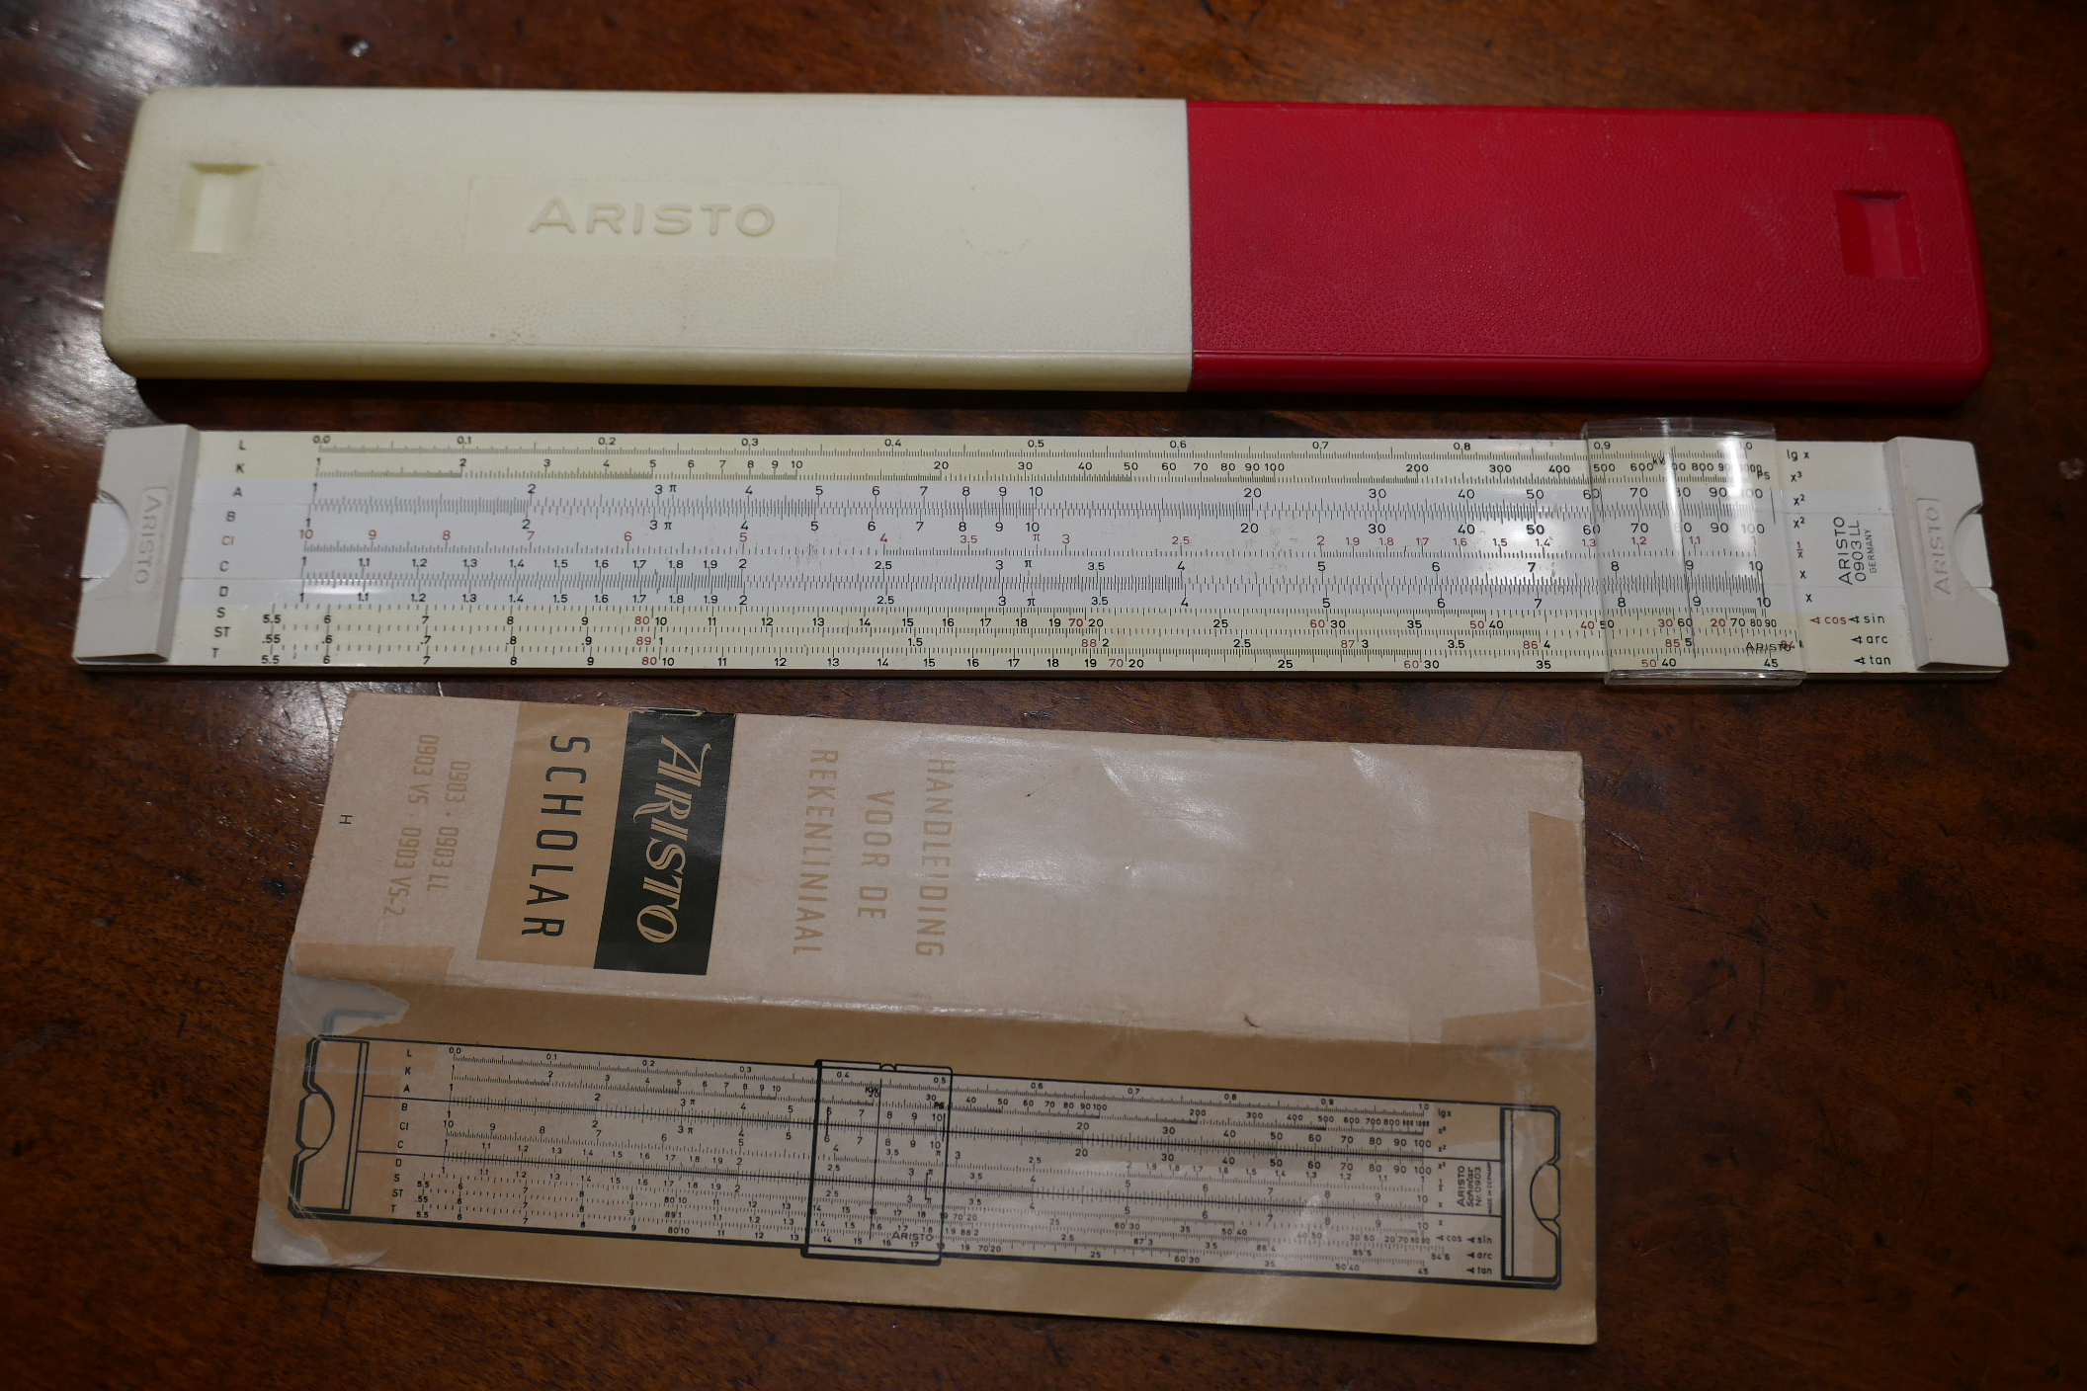
Notes:
When I was at Gymnasium Secondary School in the sixties and early seventies we did not use calculators, we only used slide rules for calculations.
At that time electronic calculators were something completely new. We gymnasium students looked upon the early cheap electronic calculators with some disdain, calling them ‘zakjapanners’, which is Dutch for ‘pocket japanese’.
We didn’t think they had any use, other than make money for the manufacterer…
In our view the only thing an educated person needed was a slide rule and maybe a good book of mathematical tables.

Slide 3
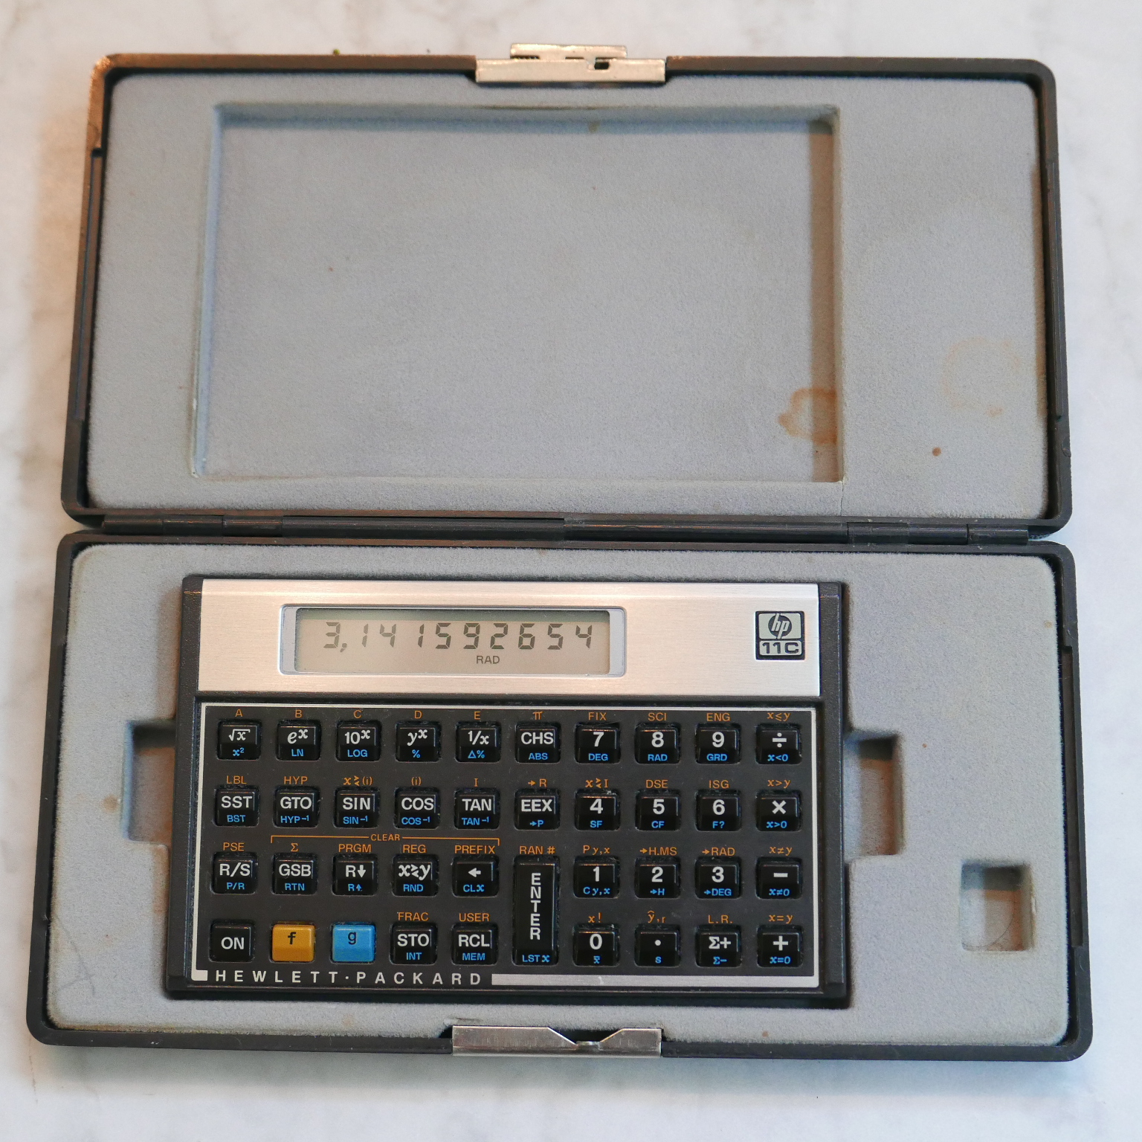
Notes:
But when I started doing research later in my study and had to do statistical calculations I began to see the usefulness of an electronic calculator.
My first acquaintance with HP calculators was in the early 80’s when I bought my first ever calculator, an HP-11C, the price of which was a small fortune for a student (more than ƒ 250). My 11C (which nowadays is mainly used by my wife by the way) still is in excellent shape thanks to this nice ‘jewel case’, which was sold in those years by one of the suppliers in the Netherlands, boekhandel Prins in Delft.

Slide 4
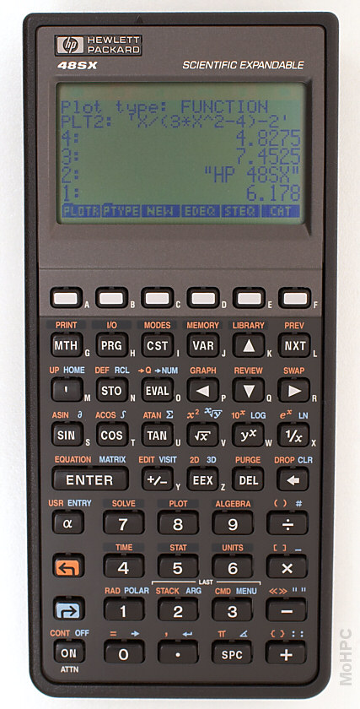
Notes:
Later, in the early 90’s, I bought an HP graphic calculator, the HP-48SX, (because of its more extensive programming capabilities) which I mainly used for power calculations for lenses that are implanted in cataract surgery.
Nowadays these formulas are built into the measuring equipment used (which are ultrasonographic or optical coherence tomographic measuring devices), and statistics is done in software packages like SPSS or the R-software environment, so there is less use for hand-held calculators in my practice.

Slide 5
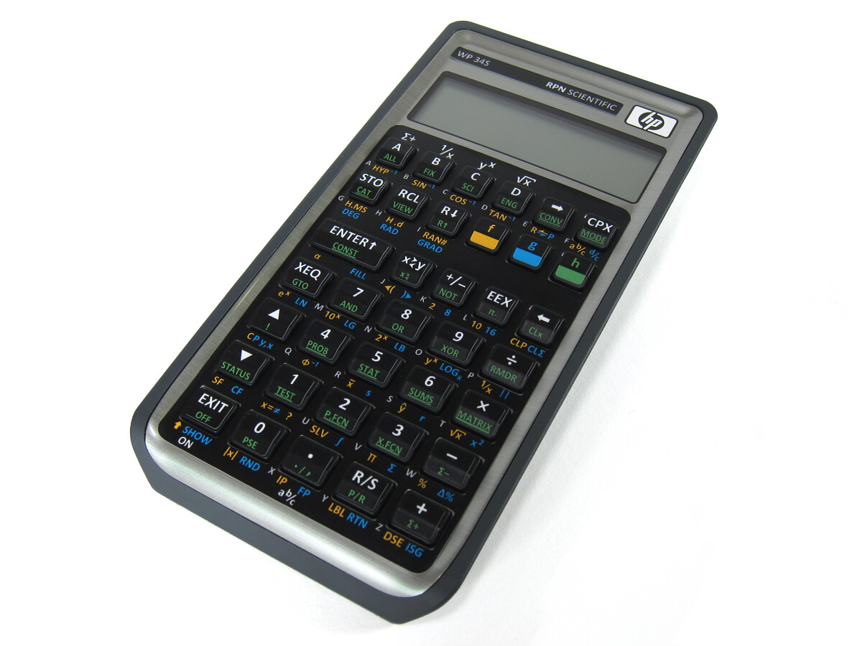
Notes:
But I still use a hand-held calculator for quick calculations, e.g. to test new formulas, or for quick statistics.
My favourite calculator nowadays is the WP-34S, of which one of the makers is present here: Walter Bonin.
Over the years I grew interested into the history of calculating devices, and so I built a small collection of HP calculators.

Slide 6
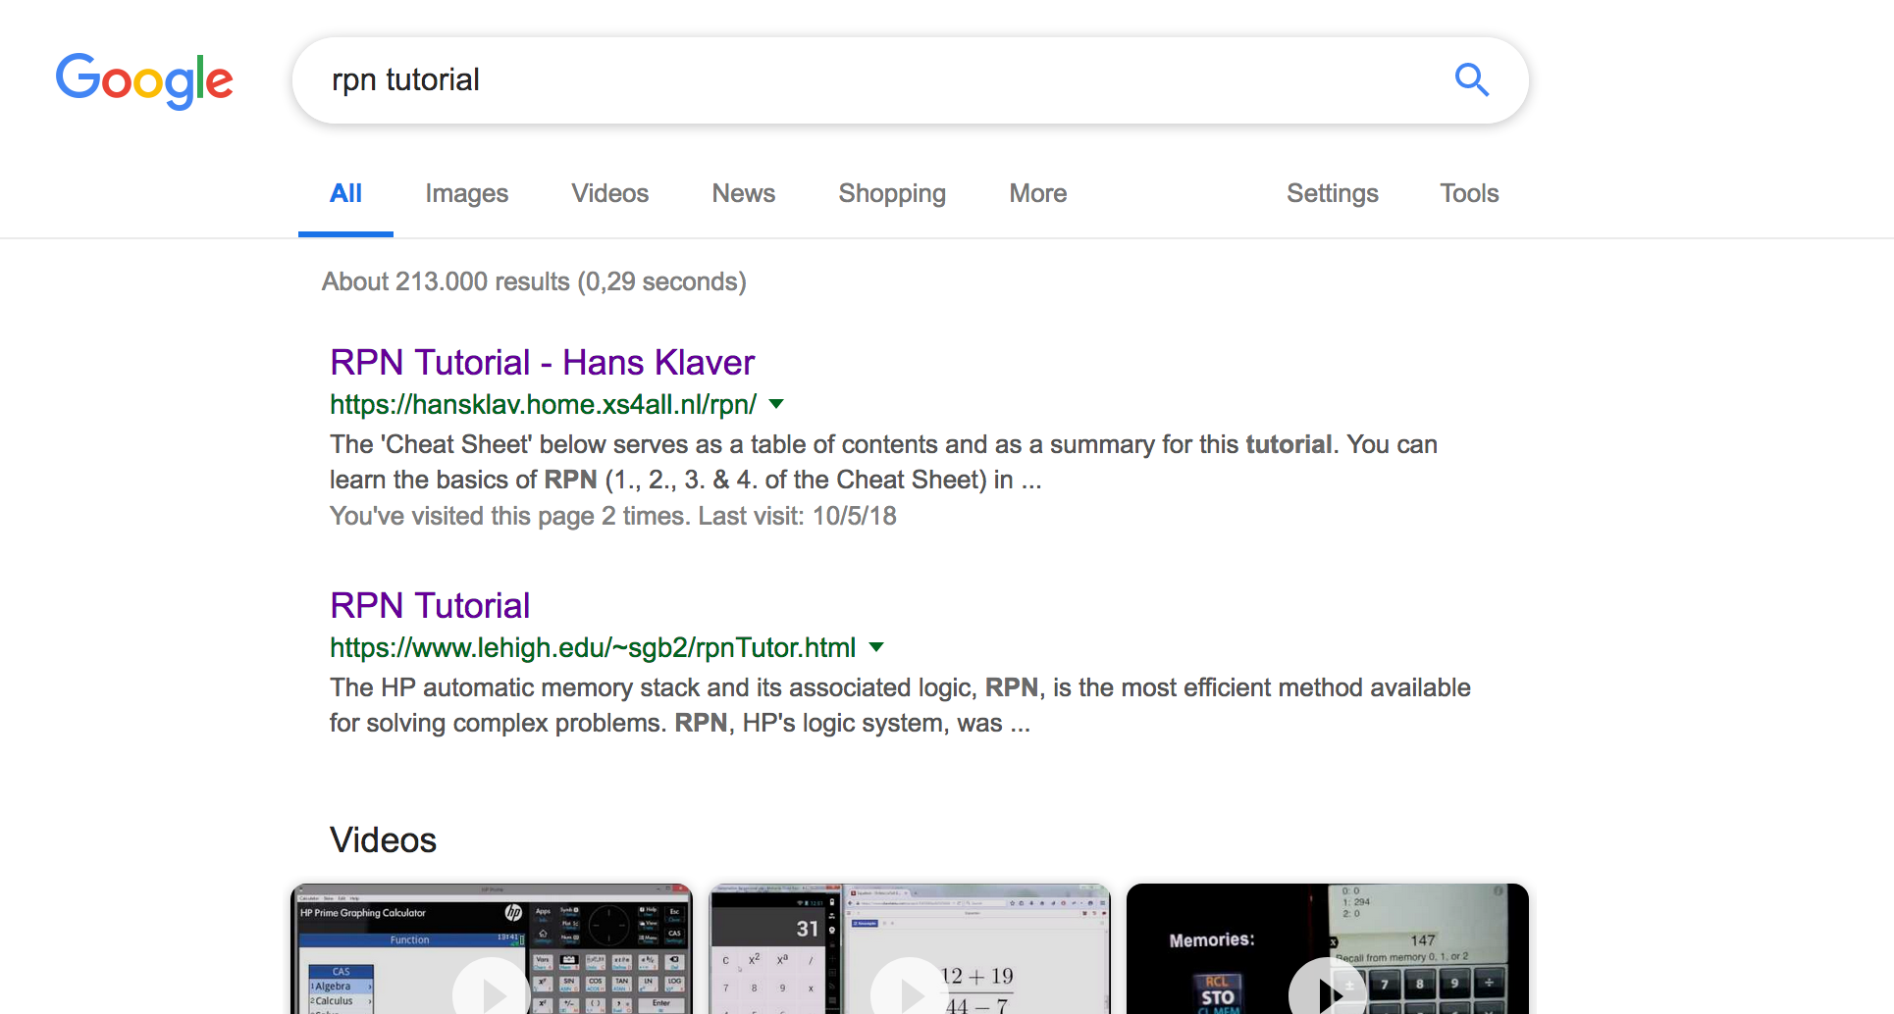
Notes:
Some of you may know my name from the RPN Tutorial web page I made a few years ago, and about which I posted on the HP Calculator Museum forum.
Google places it quite high in the list of found web pages when you search with the terms ‘rpn’ and ‘tutorial’.

Slide 7
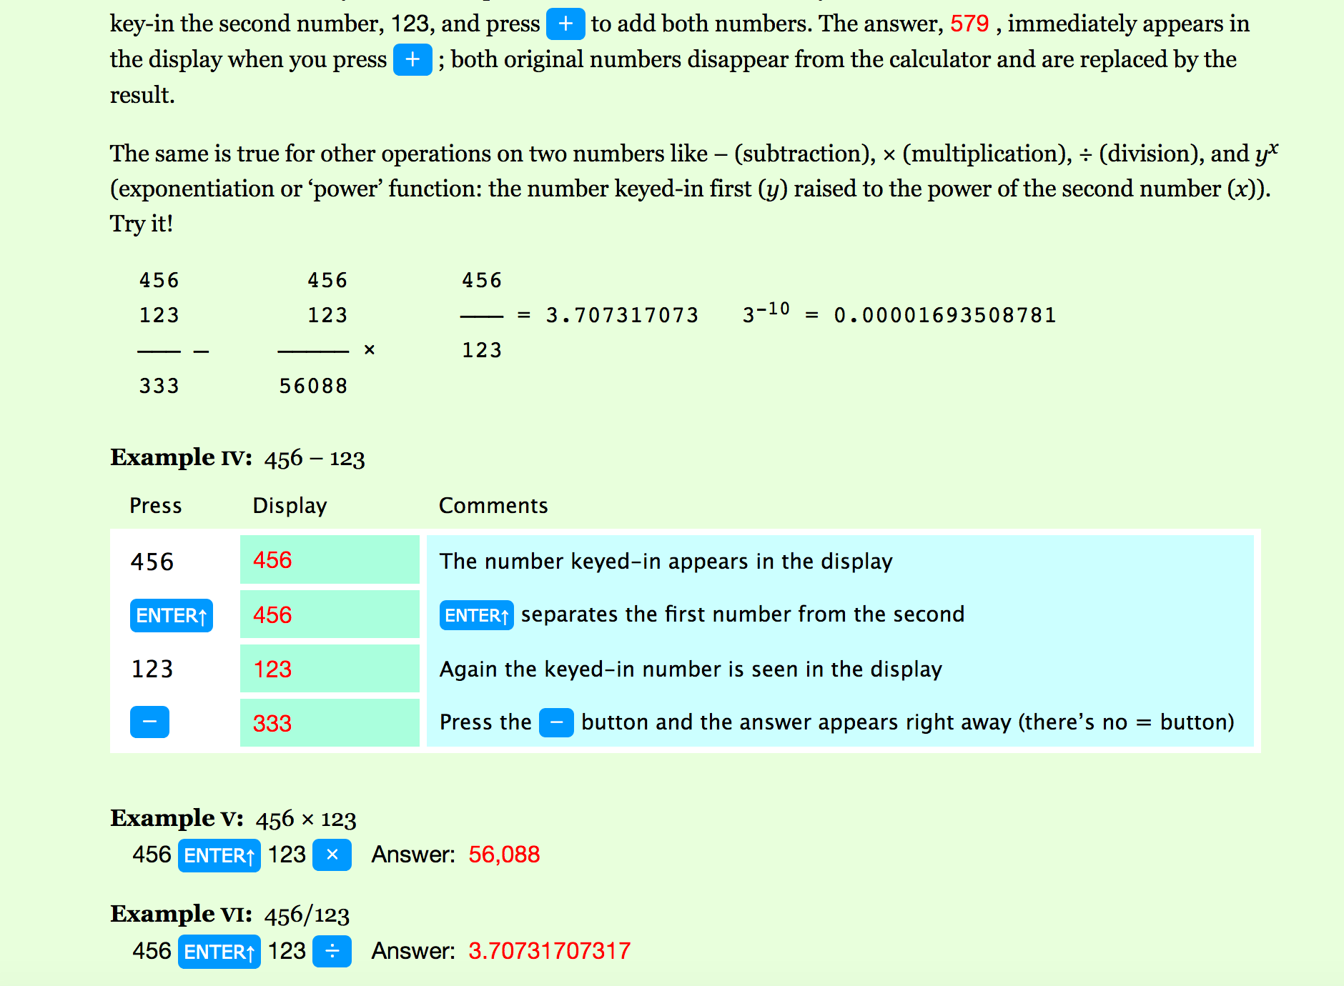
Notes:
Here you can see a glimpse of it. I was inspired for the lay-out and for the colours of this web page by the lay-out and colours of the operating manual of HP’s first hand-held calculator, the famous HP-35.

Slide 8
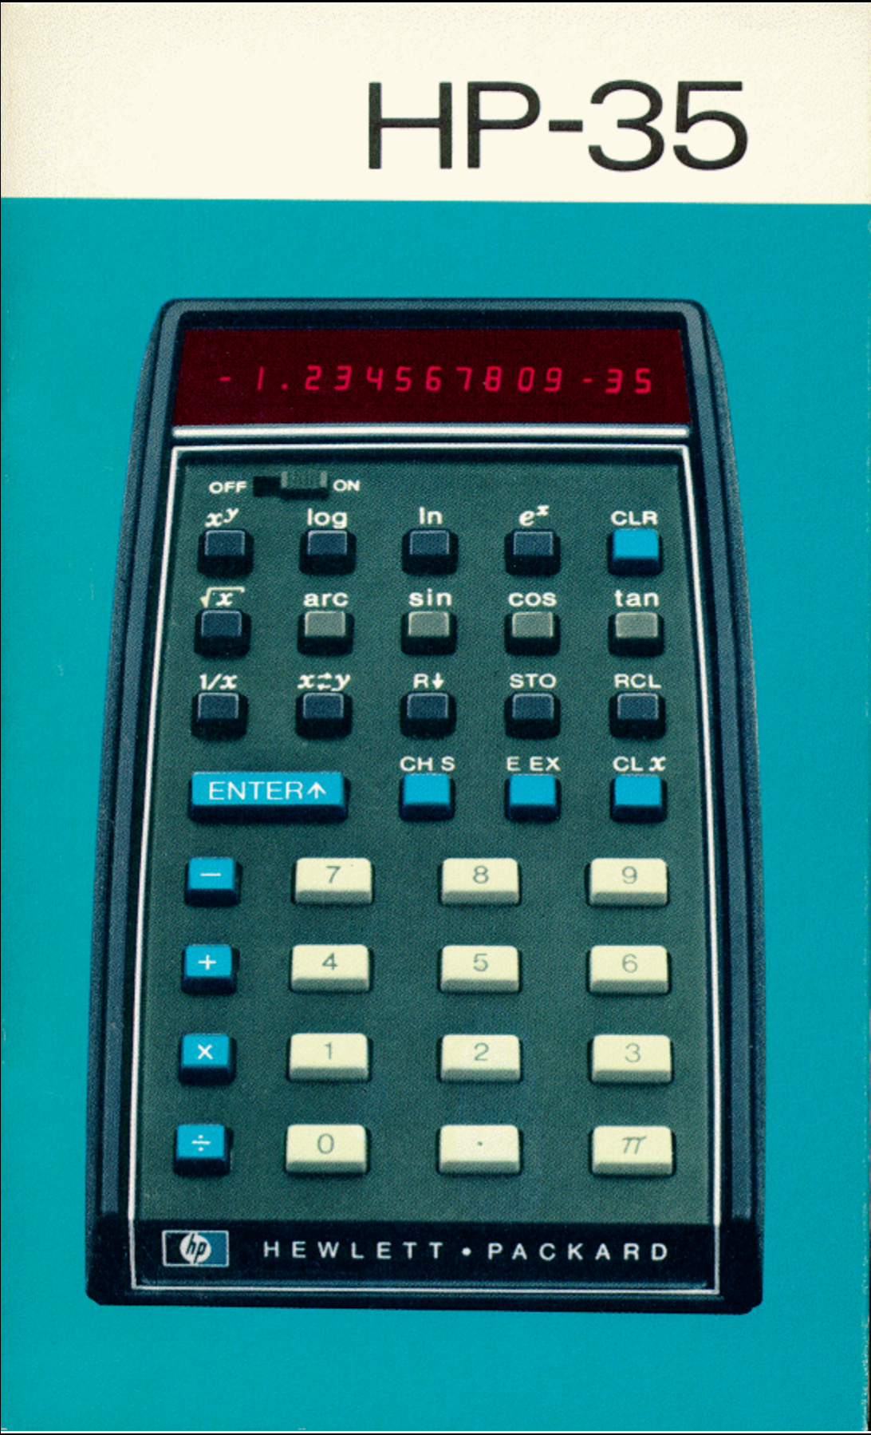
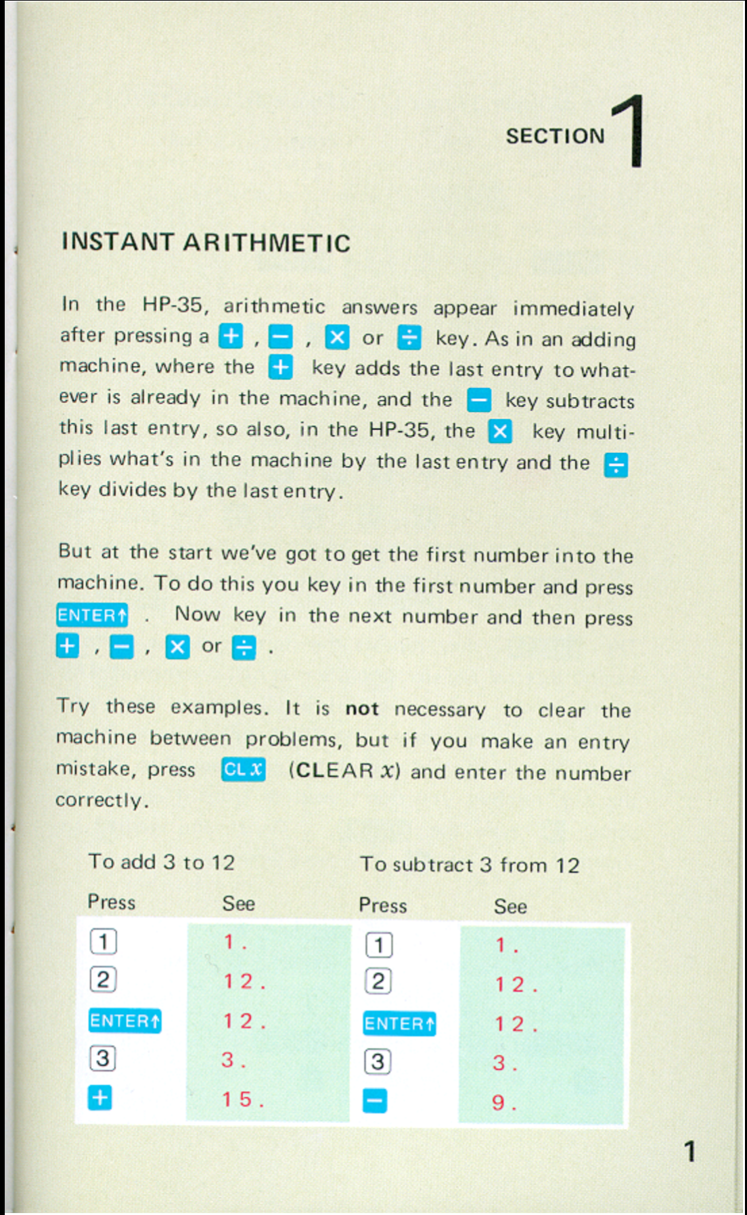
Notes:
Most of you will be familiar with this small manual which has an instructive contents but also a few shortcomings, and which has a very attractive lay-out.
You can see some example pages here…

Slide 9
Notes:
…and here.

Slide 10
Notes:
My tutorial is meant for beginners and for intermediate users of RPN calculators.
Apart from the colours and lay-out it has nothing to do with the HP-35.
It is completely generic so it’s useful for every RPN-calculator, ranging from the classical 4-level stack HP calculators up to and including the later graphical calculators like the HP prime in RPN mode.
Here you can see that it shows the use of the gold shift key and of functions that were lacking in the HP-35, but are present in most later calculators, like the square of x or percentage functions.

Slide 11
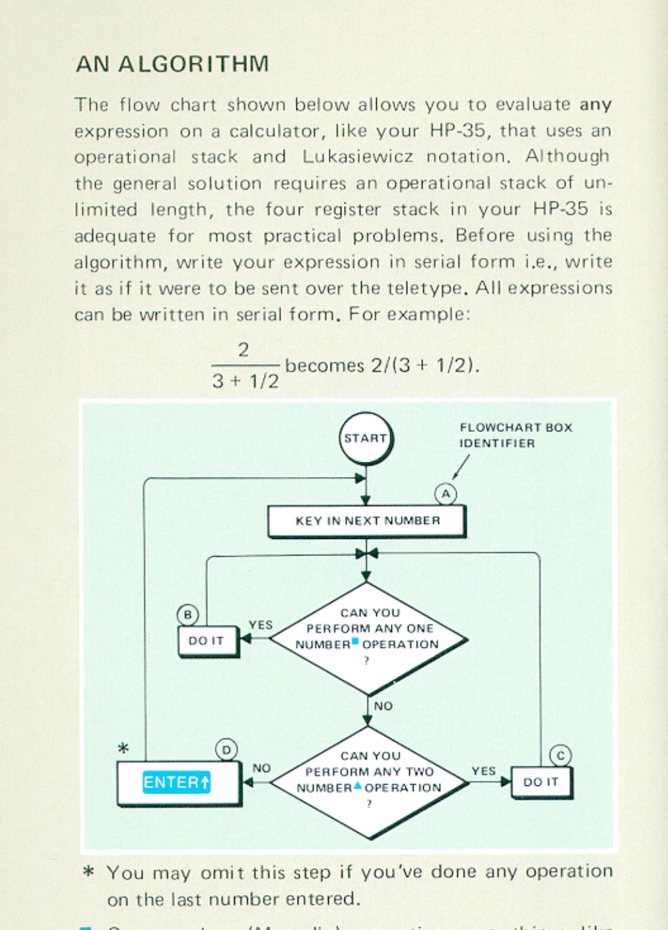
Notes:
As said I started making this web page in an attempt at convincing our two sons of the usefulness and attractiveness of the RPN user interface to calculation. At school both used Texas Instruments TI-84 Plus graphic calculators, which were standard in secondary education in the Netherlands (and still are, as far as I know). When they went to university a few years ago, one to study Civil Engineering and the other Business Administration, I looked for a suitable tutorial that told the whole story of using an RPN calculator but I was a bit disappointed in existing tutorials for beginning and intermediate RPN users, although I had all the manuals from the HP Calculator Museum available to me.
In the course of making this tutorial I became convinced that it’s a bit hard for experienced RPN-users (like most of you, I presume) to imagine the difficulties beginners have to go through before they are really at home in the RPN operational stack.
And when I studied the HP User Manuals I could see that, over the years, there is en evolution in the way the use of the stack is explained.
It seemed to me that the manual writers went through about the same steps of gradual understanding and better insight into the working of the stack that most beginners go through.
For instance, this algorithm given in the HP-35 manual is overly complicated and results in completely superfluous <ENTER> steps, …

Slide 12
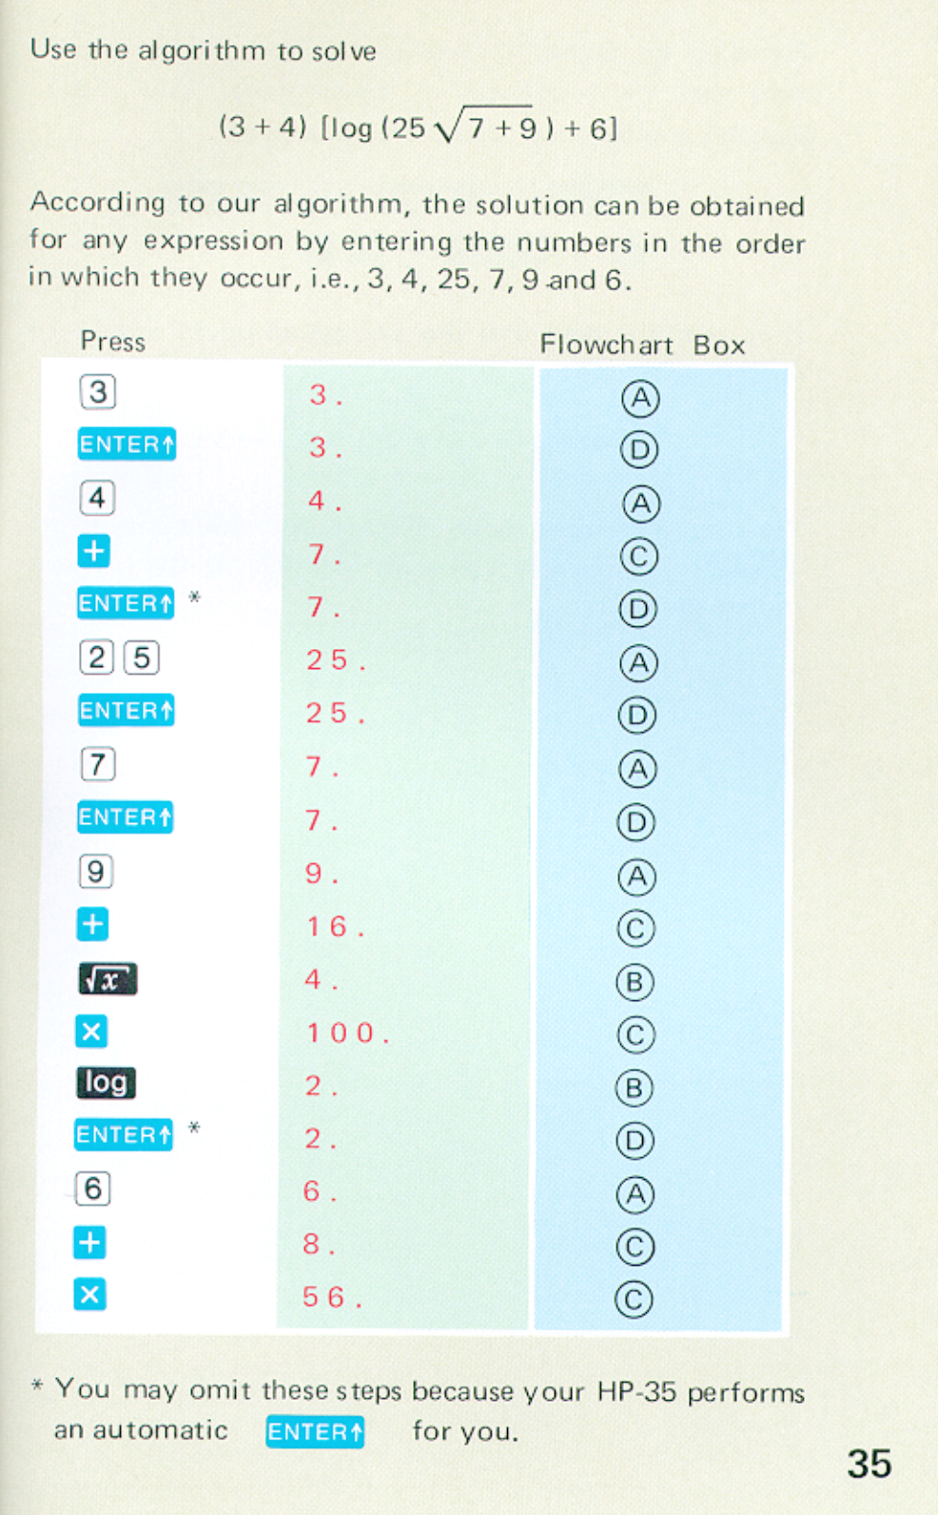
Notes:
… which are indicated: “You may omit these steps because your HP-35 performs an automatic <ENTER> for you.
That may be true, but it makes the explanation to beginners unnecessarily complicated.

Slide 13
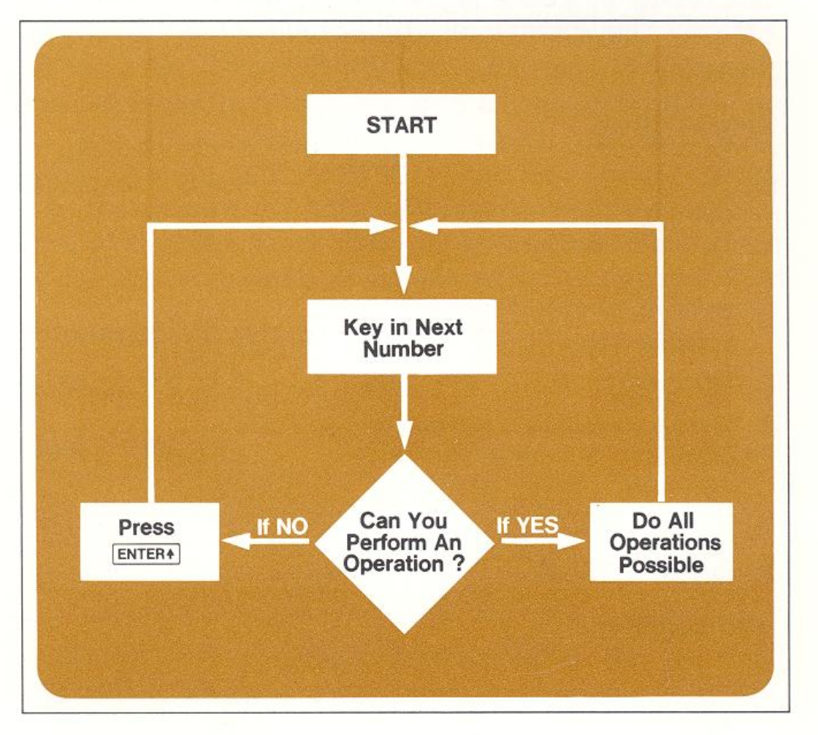
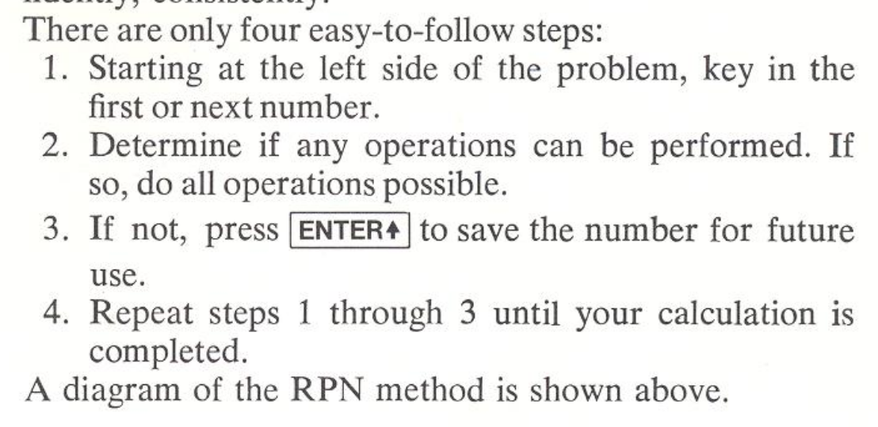
Notes:
A few years later (1974), in the booklet ‘Enter v. =’ they already made the algorithm much simpler.
But, like the HP-35 Manual this booklet advised to start a calculation at the left side of the problem, and proceed from there to the right.
And in that way in relatively simple problems with nested parentheses the stack will loose numbers from the T-register, a problem a.k.a. stack overflow.

Slide 14
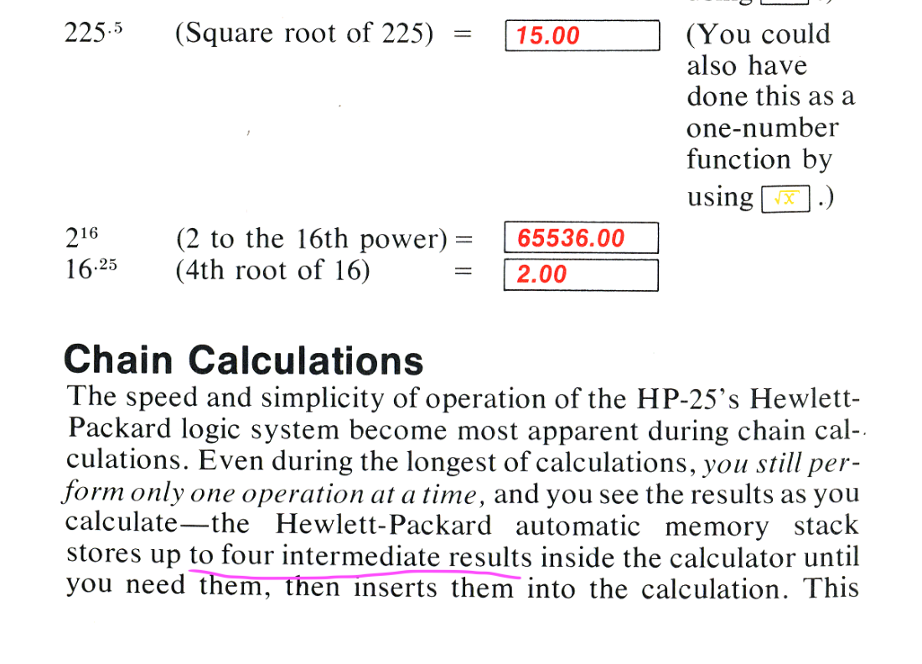
Notes:
Another example is the explanation of how many intermediate results can be stored in the ‘automatic memory stack’ during chain calculations.
E.g. in the HP-25 Manual (from 1975) one can read that ‘up to four intermediate results are stored inside the calculator until you need them’.

Slide 15
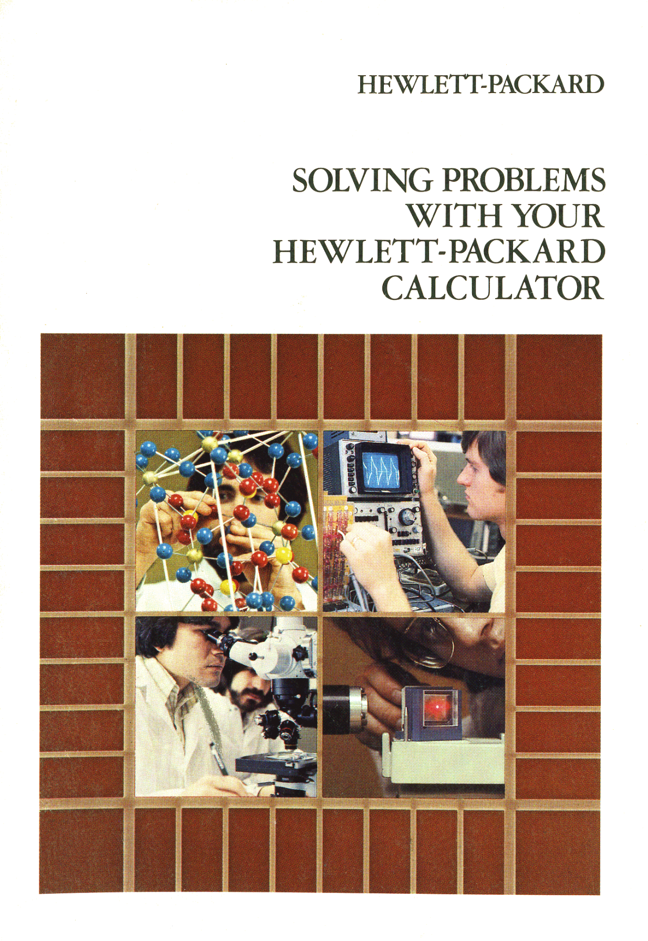
Notes:
Three years later in 1978, at the time of the HP-31, in this instruction manual one could read …

Slide 16
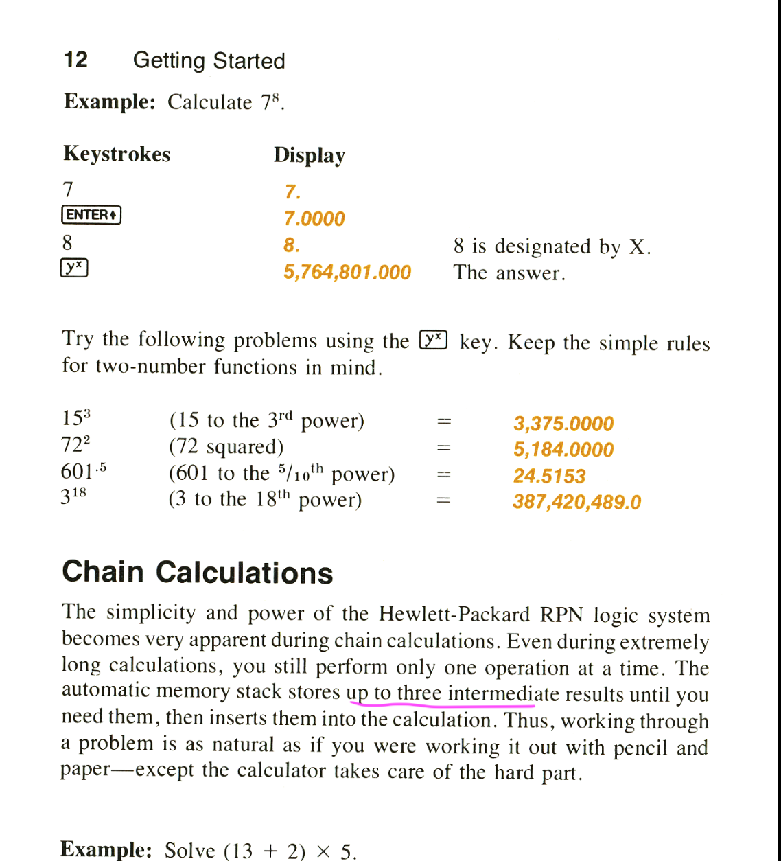
Notes:
‘The automatic memory stack stores up to three intermediate results until you need them, then inserts them into the calculation.’

Slide 17
Notes:
In the later HP-41C Manual (1979) it was “up to four intermediate results” again
You might think that the “three” in the other manual is a misprint, but that’s not very likely because the “three” was written out in full.
I can only conclude that the manual writer thought:
four intermediate results? that cannot be true!
In a way both statements are true, it depends upon two things:
the perspective that you take, the way you look at it
the next operation you have to do

Slide 18
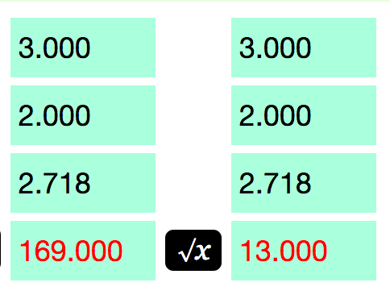
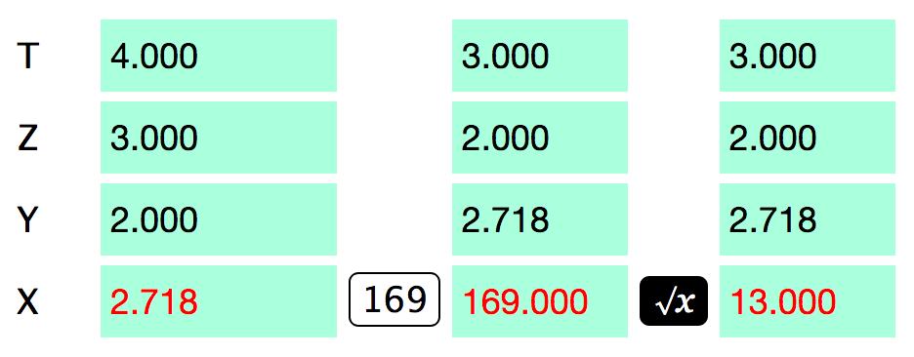
4 results from previous operations
3 (or 4?) results from previous operations
4 results from previous operations
3 results left
Notes:
Four intermediate results can only be memorized by the stack during the next operation if the next operation you do is a monadic operation done on a number already on the stack as a result of a previous operation.
Three intermediate results can be held in the stack during the next operation if the next operation is a monadic or dyadic operation with one new number keyed in by the user.

Slide 19
4 results from previous operations
2 results left
Notes:
Nowhere in any HP manual is it stated that quite frequently only two intermediate results from previous operations are preserved (s.c. when another pair of numbers between parentheses have to be keyed in).

Slide 20
Notes:
Of course when studying this kind of diagrams of the state of the stack during all steps of a calculation the user will sooner or later gain understanding of how it all works, but this takes some time.
Even experienced users sometimes have to make a diagram like this to verify an algorithm, or to show to others that the algorithm is valid.

Slide 21
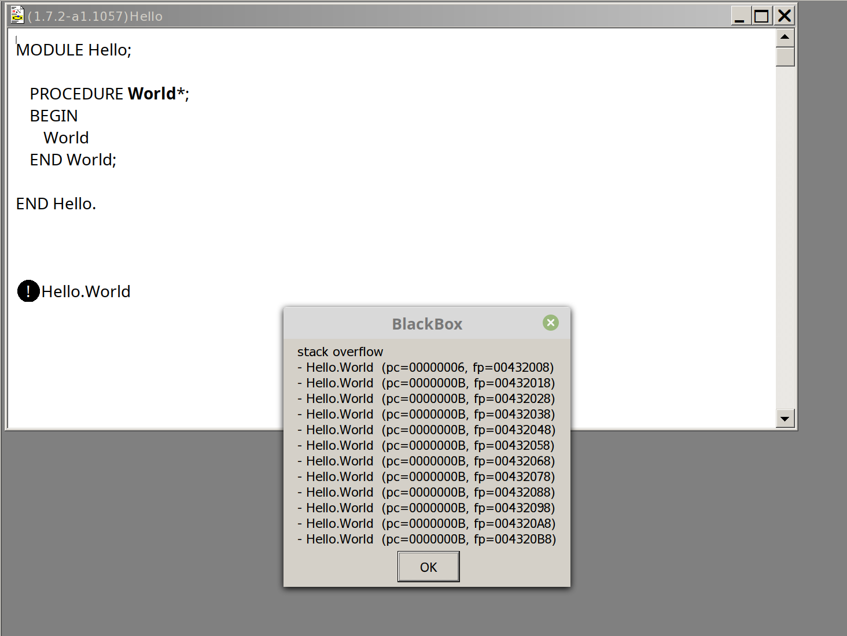
Notes:
Now, in programming, when a stack memory structure is used any decent programming language will throw an exception when there’s stack overflow.
E.g. this procedure calls itself recursively without a terminating condition and in doing so it will very soon overflow the memory stack.
By the way this is my favourite programming environment, called BlackBox Component Builder, originally made by a Swiss firm from Zurich, Oberon microsystems. It uses the programming language Component Pascal, which actually is a derivative of Oberon, by the famous Swiss professor Niklaus Wirth, the maker of Pascal and Modula-2 (among other things).

Slide 22
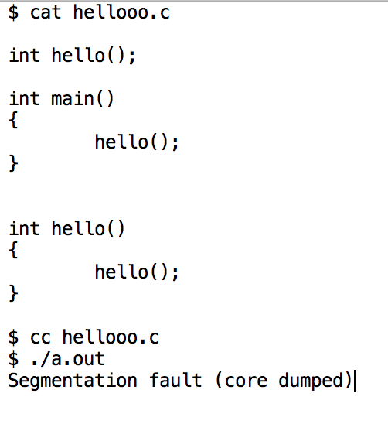
Notes:
And also in the C programming language if you do a stupid thing like this you will get some kind of message that the program is in error because of a memory violation.

Slide 23
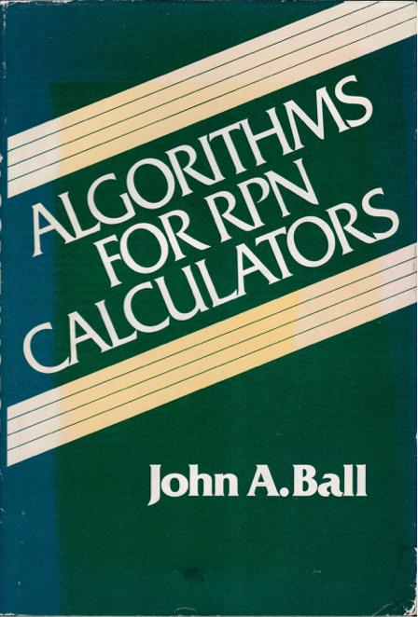
Notes:
So for a long time I have been thinking: why do RPN-calculators with their stack memory structure not give some kind of warning or indication when the stack is overflowing.
But then I thought: well, maybe it’s just me, maybe I’m just too stupid to hold this RPN stack of only 4 registers in my head.
But then I got hold of this very interesting book, which appeared in 1978, written by John A. Ball, …

Slide 24
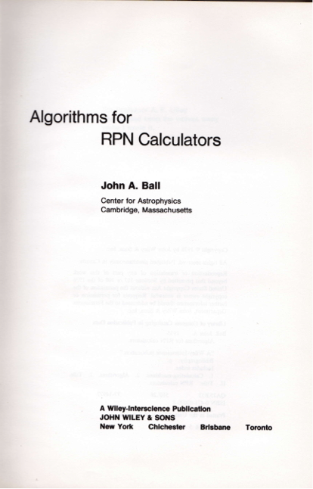
Notes:
who was an astrophysicist at the Harvard Observatory, doing work in Radio Astronomy.
And this book is a real treasure trove, not only full of algorithms for the most intricate mathematical and fysical problems, but it also gives interesting details about the history of RPN calculators.

Slide 25
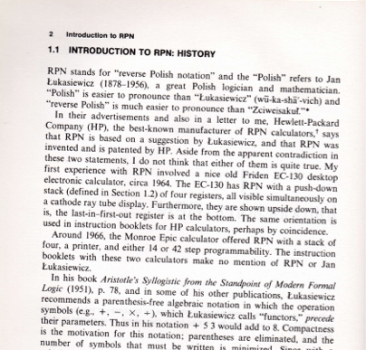
Notes:
E.g. he not only tells that RPN originates in the work by the Polish logician and mathematician Jan Lukasiewicz, but also gives us the Polish word for Reverse Polish calculus (it presume it should be pronounced something like Zciweisakul ).

Slide 26
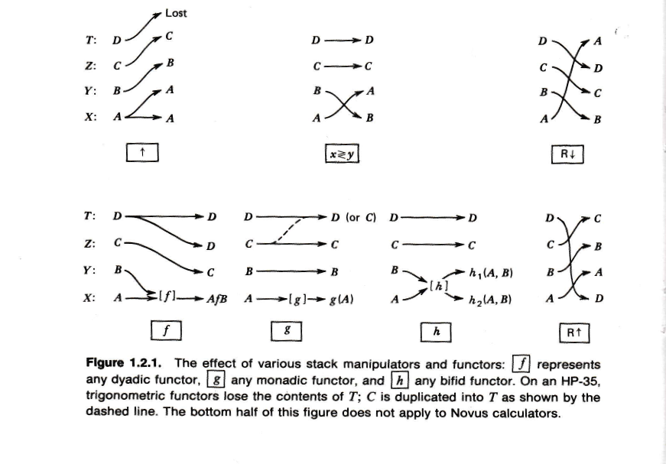
Notes:
And I learned other new RPN-terms.
I never realized that the RPN-stack that we regularly use could be called a
‘push-up’ stack. I only knew the word push-up from another context…
And I already knew the technical words ‘monadic’ and ‘dyadic’ for one and two number operations. But from this book I learned about a special kind of two number operation, called ‘bifid’ (which means ‘split’, ’split into two parts’).
Among the bifid functors he counts e.g. the percentage operations and the polar-to-rectangular and rectangular-to-polar conversions

Slide 27
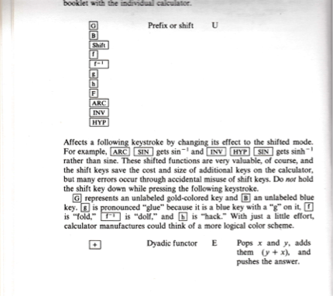
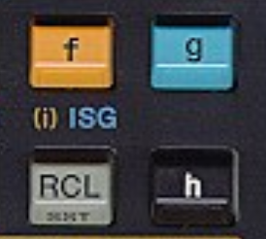
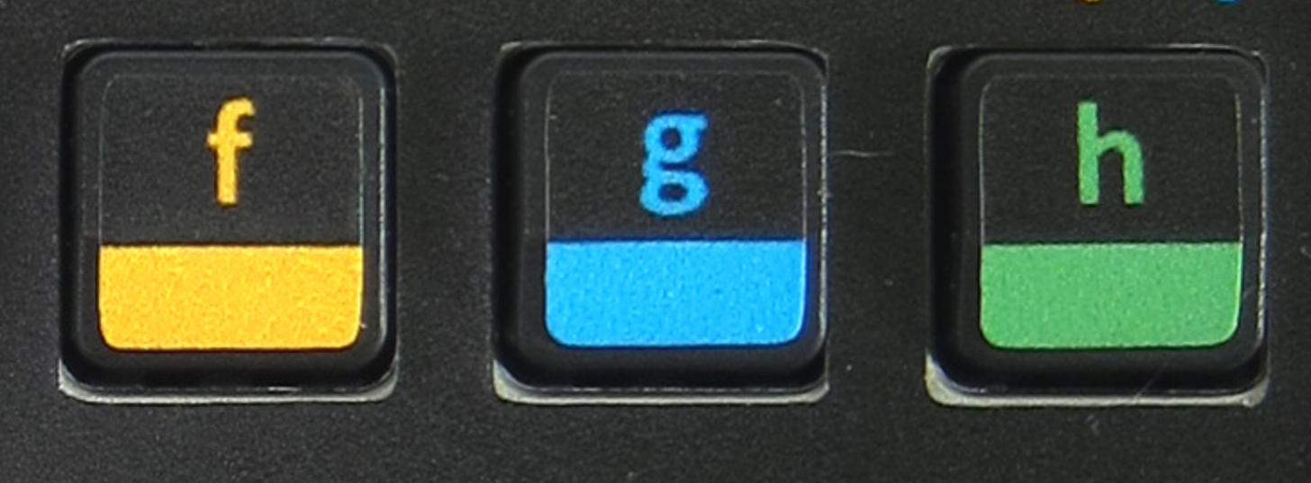
gold
(gold)
(blue)
(black)
(emerald gem)
“fold”
“dolf”
“glue”
“hack”
“hem”
HP-65
HP-34
WP 34S
Notes:
And from this book I learned the nice nicknames for the various prefix or ‘shift’ keys used in HP calculators.
These nicknames possibly have their source in the MIT and Harvard hacker culture of that time.

Slide 28
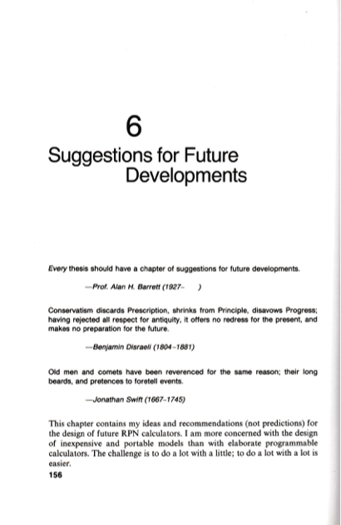
Notes:
But what I found most interesting in this book from the perspective of my thoughts about SOS was this chapter on Suggestions for Future Developments.
In this chapter John Ball gives his ideas and recommandations for the design of future RPN calculators.
And indeed, some of his recommandations, done in 1978, have been implemented into later calculators.
E.g. he suggested to include complex number operations.

Slide 29
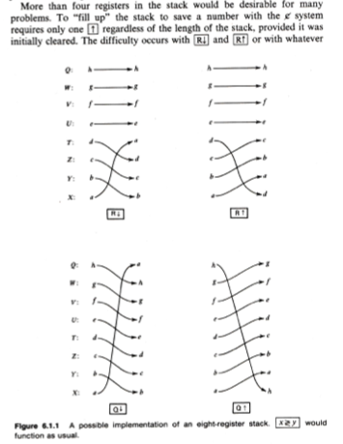
Notes:
E.g. in 1978 he already suggested an eight level stack.
But his proposal was a bit different from the eight level stack in the WP 34S. He suggested to let the R up and down keys remain the same, only used for 4 level rolls, and two other operators for 8-level rolls: Q up and down.

Slide 30
Notes:
And he also proposed a scheme to let the user ensure that no numbers are lost off the top of the stack during a calculation.
But his scheme is rather convoluted, and needs a special symbol for ‘clear’, distinct from zero, but which could function as a zero in various operations.
And you had to use a whole new way of entering a number, not using the enter key but the R-up key. Then on pressing the R-up key, a ‘clear’ appears in X, provided the stack is not full. So by watch for the ‘clear’ after each R-up, one can ensure that there was no stack overflow up to that moment.
It is understandable that such a complicated scheme to indicate stack overflow never was implemented in any calculator afterwards.
But the fact that he proposed something like that made me think: if he finds it useful to watch that no numbers are lost off the top of the stack, and he’s an astofysicist and he knows a lot more about RPN than I do, then maybe SOS is not such a bad idea at all.
But I had the feeling that his was not the simplest possible scheme to implement SOS.

Slide 31
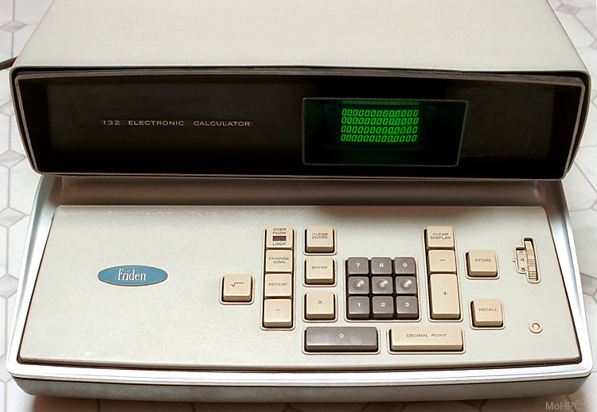
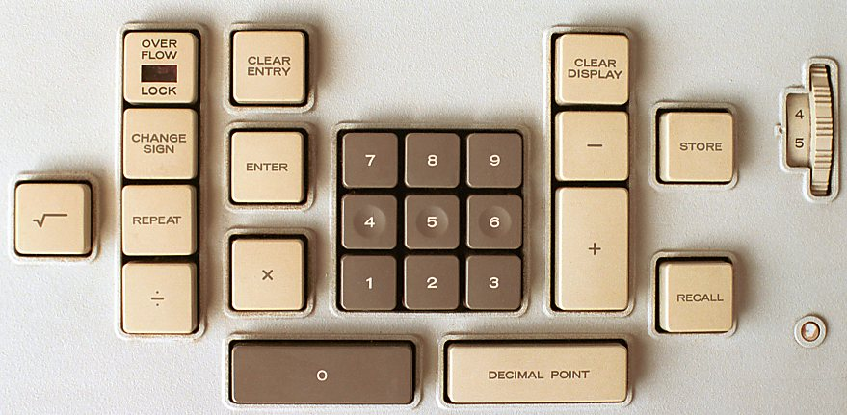
Notes:
Then, after a while thinking about this, two old RPN calculators turned on a light in my mind: the Friden EC-130/132 and a rare early model of the HP-35.
This Friden calculator came out in 1966, and thus preceded all HP calculator models (the desktop HP-9100 series started in 1968).
Is a very interesting calculator. Its stack logic (which Friden didn’t call RPN) more resembles that of the later handheld HP calculators like the HP-35 than HP’s own 9100 series.
So it is a bit unfair that the Friden stack logic is called “not quite RPN” on the HP Calculator Museum website.
But to me the feature that immediately catched my eye was this key with a light indicating overflow. Later on I learned that it did not signal stack overflow, but numeric overflow like division by zero etc. But even so I thought: that’s a bright idea: a light that signals overflow!

Slide 32
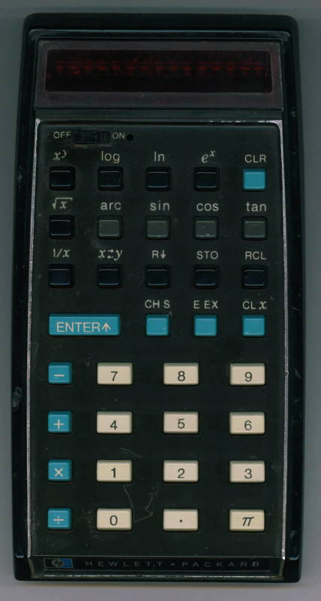
Notes:
Then I thought of a rare early HP-35 model I had once read about: the HP-35 “red dot”, which has a small LED next to the power switch indicating “power on”.
No later HP calculator has a power light, because it is hardly useful and only a waste of energy. But I thought: It could have been used by HP for a much more useful purpose: signalling stack overflow!

Slide 33
Notes:
On my RPN Tutorial page I already had a link to the HP-35 simulator page of Neil Fraser. I thought: maybe this is the ideal calculator to show a proof of concept for a calculator with SOS! In the past I already had looked at his open source JavaScript code.
And I thought: maybe I can implement an SOS scheme in this calculator and use the red dot as a flag!
And the word ON next to the power switch gave me another idea: why not put its mirror image NO on the other side of the red dot, NO meaning No Overflow, so the red dot lights as long as there is No Overflow and distinguises in case of stack overflow.
The HP-35 has another feature that I could use: the CLR key, which is quite useless in an RPN calculator, but when you want to watch for stack overflow it can become very useful!

Slide 34
Notes:
An interesting thing about this implementation is that it’s very unintrusive: if you have no need for it you can just ignore it. But if you would like the help of SOS you can use it just by pressing the CLR key before you start a long calculation about which you are not sure that it will not overflow the stack and so arrive at a wrong answer.
My system is not noticed when you don't need it, does not need a special symbol for empty, and only would need a small annuntiator in the screen, NO, which would work like the red dot, and a key to clear the stack to start it (e.g. CLR, CLS or CLSt) which might be a shifted function.
It’s like a very simple Automatic Theorem Prover: as long as the light is ON your theorem is valid, the theorem being “No Stack Overflow”!
Of course this particular implementation, the HP-35 SOS, is only a “proof of concept”.
John Ball's scheme would work more preventive in the sense that you can see that the stack is full before you overflow it, but is more complex for the user: it needs a separate symbol for "empty" and a whole new way of working with the stack, using the roll-up key for entering a number.

Slide 35
Please let me know what you think of it
Do you think it’s a useful feature for a small stack RPN calculator, or is it completely superfluous?
Do you think the course of history of RPN calculators would have been different if HP would have implemented such a scheme into its HP-35 45 years ago?
Do you think it will ever be implemented in a future hardware RPN calculator?

